Slide 1



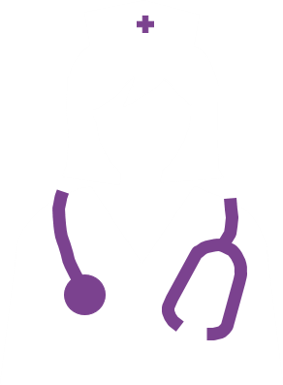

Active management of veno-occlusive disease (VOD)
Haematopoietic stem cell transplantation
Pathophysiology of VOD
Diagnosis of VOD
Assessment and management
of VOD
VOD case studies

Slide 2
Contents
Module 1: Haematopoietic stem cell transplantation
Module 2: Pathophysiology of VOD
Module 3: Diagnosis of VOD
Module 4: Assessment and management of VOD
Module 5: VOD case studies

Slide 3

How to use the veno-occlusive disease (VOD) learning programme modules
Please download the folder containing all of the modules onto your computer. This will ensure that the links between the modules work
You should navigate through the modules in the slide presentation mode. There are links to content in other modules, additional information and external references
The icon indicates that further information is available on the topic. Please click on this symbol to access the additional information. Simply advance to the next slide to return to the slide you were on
There are video clips within some sections that you can access by clicking the play button indicated on the slides
The multi-choice questions at the end of each module allow you to test your knowledge

Slide 4
Module 2:
Pathophysiology of VOD

Slide 5
Learning objectives
To understand the cause of VOD
To understand the sequence of steps in the pathophysiology of VOD
To recognise the pathophysiological endpoint of VOD
VOD, veno-occlusive disease

Slide 6

Early complications of HSCT: vascular endothelial syndromes
Intense and sustained activation of endothelial cells leads to cellular damage
Alloreactivity (the immune response in reaction to the transplanted stem cells) has been postulated to play a role in this damage and activation
  This explains the greater incidence of certain complications (e.g. GvHD) after allogeneic transplantation
DURING HSCT
Conditioning regimen
Module 1 link
Cytokines produced by injured tissues
Activation of endothelial cells lining the blood vessels
Microbial translocation through mucosal barriers
Engraftment process
Carreras E, Diaz-Ricart M. Bone Marrow Transplant 2011;46:1495–502
GvHD, graft-versus-host disease; HSCT, haematopoietic stem cell transplantation

Slide 7

Early vascular endothelial syndromes after HSCT have a common pathogenesis
Multi-organ dysfunction syndrome
VOD
DAH
ES
IPS
TAM
TAM
CLS
ES
TAM
Organ
dysfunction
Endothelial
dysfunction
(pathological)
Endothelial phenotype represents a net liability to the host
(capillary flow obstruction, fibrin-related aggregates,
platelet and leukocyte adhesion, endothelial apoptosis)
Endothelial
activation
(physiological)
Pro-coagulant
status
Inflammatory
response
Increased permeability
Vasoconstriction
Conditioning
G-CSF
CNI
LPS/infections
Engraftment
Alloreactivity
Haematopoietic stem cell transplantation
Carreras E, Diaz-Ricart M. Bone Marrow Transplant 2011;46:1495–502
CLS, capillary leak syndrome; CNI, calcineurin inhibitors; DAH, diffuse alveolar haemorrhage; ES, engraftment syndrome;
G-CSF, granulocyte-colony stimulating factor; HSCT; haematopoietic stem cell transplantation; IPS, idiopathic pneumonia syndrome; LPS, lipopolysaccharide; TAM, transplant-associated microangiopathy; VOD, veno-occlusive disease

Slide 8
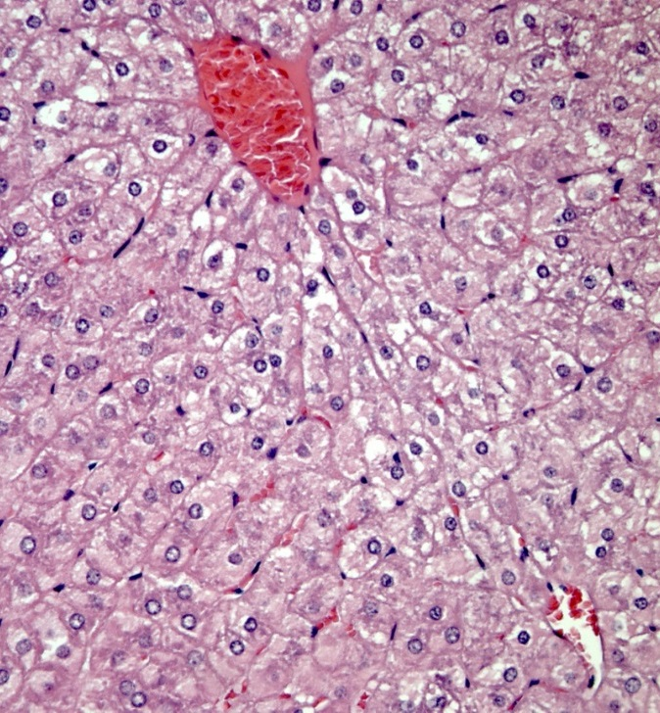
Vascular endothelial damage in the liver: veno-occlusive disease (VOD)
Classical VOD occurs within the first 21 days after HSCT
The conditioning regimens given before HSCT result in the production of toxic metabolites by the hepatocytes in the liver
These metabolites trigger the activation, damage and inflammation of the endothelial cells that line the sinusoids – small capillary-like blood vessels found in the liver
This ultimately leads to VOD, which is characterised by fluid retention and ascites, jaundice, weight gain, and painful hepatomegaly
In severe cases, VOD is associated with multiple organ failure, and a mortality rate of >80%
VOD, also known as sinusoidal obstruction syndrome (SOS), is a potentially life-threatening complication of HSCT that occurs in 10–15% of adult HSCT patients
Module 1 link
Histological section of the liver viewed through a microscope. Blood vessels shown in red, cell nuclei in blue, cytoplasm in pink
Dalle JH, Giralt SA. Biol Blood Marrow Transplant 2016;22:400–9;
Richardson PG et al. Expert Opin Drug Saf 2013;12:123–36;
Mohty M et al. Bone Marrow Transplant 2016;51:906–12
HSCT, haematopoietic stem cell transplantation

Slide 9
The pathophysiology of VOD is multifactorial and complex
Endothelial cell and hepatocyte damage
Triggering of multiple pathways
Thrombosis
Fibrinolysis
Inflammation
Cytoskeletal structure
Sinusoidal narrowing
VOD
Richardson PG et al. Expert Opin Drug Saf 2013;12:123–36;
Coppell JA et al. Blood Rev 2003;17:63–70; Carreras E et al. Bone Marrow Transplant 2011;46:1495–502
VOD, veno-occlusive disease
Notes:
The initial trigger for VOD is the activation and damage of the sinusoidal endothelial cells due to toxic metabolites resulting from the HSCT conditioning regimen¹
Inflammatory mediators such as cytokines and chemokines are released along with the enzyme heparanse, which breaks down the extracellular matrix¹
The rounding up of endothelial cells allows red blood cells, white blood cells and other debris accumulates in the space of Disse, leading to sinusoidal narrowing
Endothelial cells dissect off and embolise downstream, further contributing to this narrowing¹
A procoagulant and hypofibrinolytic state is also characteristic of VOD¹
This can lead to the complete obstruction of the hepatic sinusoids. In severe cases this can lead to multi-organ failure and death¹⁻³
References
Richardson PG et al. Expert Opin Drug Saf 2013;12:123–136
Bearman SI. Blood 1995;85:3005–3020
Coppell JA et al. Blood Rev 2003;17:63–70

Slide 10
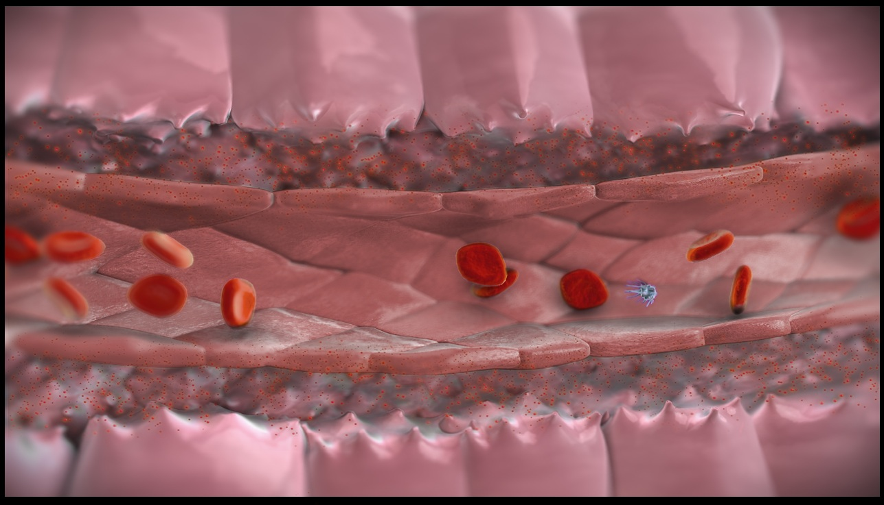
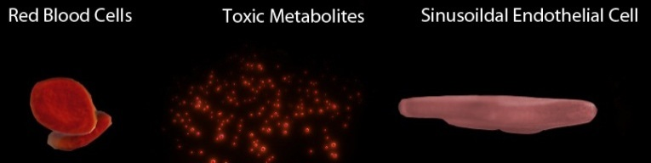

1. Cell toxicity resulting from conditioning chemotherapy damages the lining of the liver sinusoids
The chemotherapy agents used as conditioning regimens for HSCT are metabolised in the liver
Toxic metabolites resulting from the breakdown of these agents are released by the hepatocytes (the main functional cells of the liver)
These metabolites cause damage and activation of the sinusoidal endothelial cells (SECs) which line the sinusoids (the small capillary-like blood vessels found in the liver)
Hepatocytes
Module 1 link
Space of Disse
Sinusoid
Space of Disse
Hepatocytes
Red blood cells
Toxic metabolites
Sinusoidal endothelial cells
Platelets
Toxic metabolites resulting from the HSCT conditioning regimen damage and activate the sinusoidal endothelial cells
Richardson PG et al. Expert Opin Drug Saf 2013;12:123–36
HSCT, haematopoietic stem cell transplantation

Slide 11
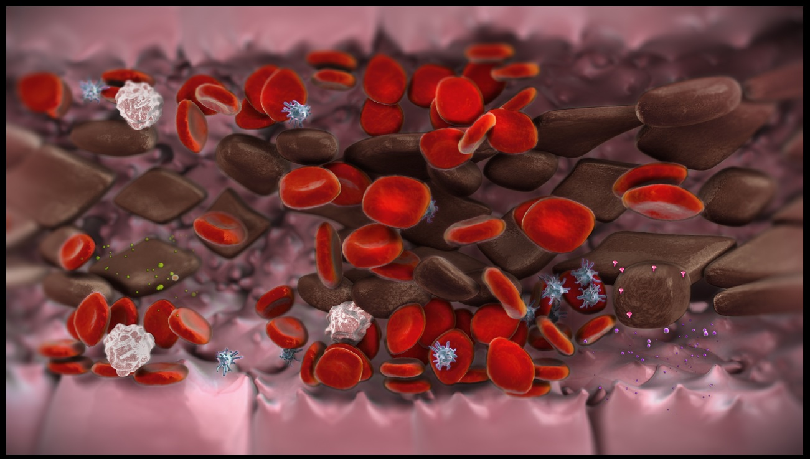
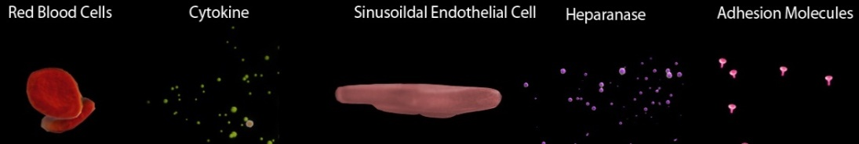

2. Activation of sinusoidal endothelial cells can trigger multiple pathways, resulting in inflammation and narrowing of the sinusoids
The cell damage leads to the increased release of inflammatory chemicals
These trigger inflammatory pathways that further damage the SECs
Activated SECs also release heparanase, which breaks down the extracellular matrix (which usually holds together cells to form the endothelium), resulting in the loss of cytoskeletal structure
As a result, SECs group together and gaps start to form in the endothelial lining
Red blood cells and other cell debris leak into the Space of Disse, the space located between the endothelium and the hepatocyte, leading to narrowing of the sinusoids
SECs can break off and travel into the bloodstream, resulting in a blockage of the sinusoid
Red blood cells
Toxic metabolites
Sinusoidal endothelial cells
Platelets
Red
blood cells
Sinusoidal endothelial cells
Sinusoidal endothelial cells
Platelets
Red blood cells
Toxic metabolites
Adhesion molecules
Platelets
White
blood cells
Cytokines
Cytokines
Heparanase
Platelets
Richardson PG et al. Expert Opin Drug Saf 2013;12:123–36
SEC, sinusoidal endothelial cell

Slide 12
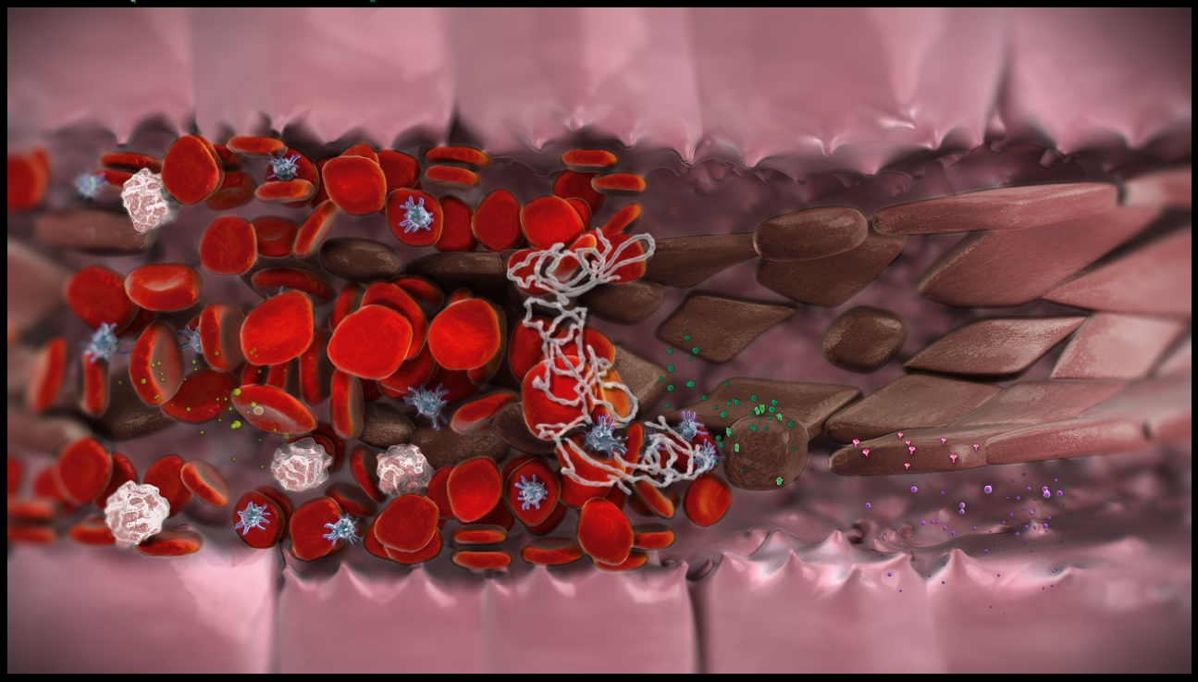

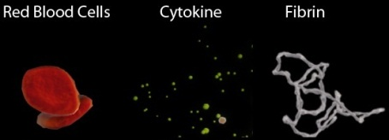
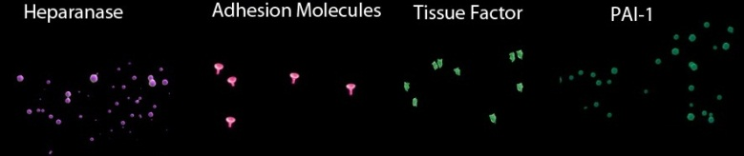
3. VOD is characterised by increased clot formation and reduced clot breakdown
In addition, an increase in the expression of tissue factor (TF) and plasminogen activator inhibitor-1 (PAI-1) causes an increase in clot formation and a decrease in the breakdown of clots
Clots forming at the sites of endothelial damage cause further obstruction of the sinusoid
The narrowing of the sinusoids, embolised endothelial cells, and increased clot formation, all lead to the endpoint of VOD,
i.e. obstruction of the sinusoids and ultimately reduced hepatic venous outflow
Sinusoidal endothelial cells
Red blood cells
Toxic metabolites
Sinusoidal endothelial cells
Platelets
Red blood cells
Sinusoidal endothelial cells
Heparanase
Adhesion molecules
Platelets
Toxic metabolites
Platelets
Red blood cells
Cytokines
Sinusoidal endothelial cells
Adhesion molecules
White
blood cells
Red blood cells
Cytokines
Heparanase
Platelets
Red blood cells
Cytokines
Cytokines
Cytokines
Fibrin
Heparanase
Adhesion molecules
Tissue factor
PAI-1
Platelets
Richardson PG et al. Expert Opin Drug Saf 2013;12:123–36
VOD, veno-occlusive disease

Slide 13
VOD can also occur later than 21 days after HSCT
VOD usually develops within 21 days after HSCT but can occur later in 15–20% of cases (late-onset VOD)
  One-third of cases occur after patient discharge
The frequency of late-onset VOD has increased over the past few years due to the changing natural history of HSCT
  Alternative donors
  Reduced-intensity conditioning (RIC) regimens
Late-onset VOD is frequently confused with other causes of liver dysfunction such as acute GvHD, viral hepatitis, drug-induced liver disease or sepsis
Mohty M et al. Bone Marrow Transplant 2016;51:906–12; Carreras E. Early complications after HSCT. In: Apperley J, Carreras E,
Gluckman E, Masszi T eds. ESH-EBMT Handbook on Haematopoietic Stem Cell Transplantation. Genova: Forum Service Editore, 2012;176–95
GvHD, graft-versus-host disease; HSCT, haematopoietic stem
cell transplantation; VOD, veno-occlusive disease

Slide 14
Summary of VOD pathophysiology
VOD, also known as SOS, is a potentially life-threatening complication of HSCT that occurs in 10–15% of adult HSCT patients
It typically occurs as an early complication (within 21 days), but can occur later in some patients
The conditioning regimen given prior to HSCT increases endothelial cell activation, resulting in damage to the SECs and hepatocytes
The accumulation of cells in the Space of Disse (the perisinusoidal space) increases inflammation, and formation of clots leads to narrowing of the sinusoids
This results in VOD, which is characterised by blockage of the sinusoids, portal vein hypotension and reduced hepatic venous outflow
HSCT, haematopoietic stem cell transplantation; SEC, sinusoidal endothelial cell;
SOS, sinusoidal obstruction syndrome; VOD, veno-occlusive disease

Slide 15
Self-assessment questions
On average, in what proportion of adult HSCT patients does VOD occur?
  15–21%
  10–15%
  25–31%
  40–47%
HSCT, haematopoietic stem cell transplantation; VOD, veno-occlusive disease
Notes:
b) 10–15%

Slide 16
Self-assessment questions
Which other vascular syndromes should you be aware of when diagnosing potential VOD?
  Capillary leak syndrome
  Peripheral artery disease
  Engraftment syndrome
  Transplant-associated microangiopathy
  Diffuse alveolar haemorrhage
  Idiopathic pneumonia syndrome
Click on the answer that you think is correct
a, c, d, e, f
c, d, e
b, c, e, f
VOD, veno-occlusive disease
Notes:
a) Capillary leak syndrome
c) Engraftment syndrome
d) Transplant-associated microangiopathy
e) Diffuse alveolar haemorrhage
f) Idiopathic pneumonia syndrome
NOT b) Peripheral artery disease

Slide 17
Self-assessment questions
What are sinusoidal endothelial cells (SECs)?
  The cells that line the capillary-like blood vessels of the liver
  Stem cells from transplantation
  Red blood cells in the liver
Notes:
a) The cells that line the capillary-like blood vessels of the liver

Slide 18
Self-assessment questions
In the context of VOD, put the following events in order:
  Inflammation/thrombosis/damage to cytoskeletal structure and decreased fibrinolysis
  Endothelial cell damage
  Sinusoidal obstruction
  HSCT conditioning
Click on the answer that you think is correct:
a, c, d, b
d, b, a, c
d, c, b, a
HSCT, haematopoietic stem cell transplantation; VOD, veno-occlusive disease
Notes:
d) HSCT conditioning
b) Endothelial cell damage
a) Inflammation/thrombosis/damage to cytoskeletal structure and decreased fibrinolysis
c) Sinusoidal obstruction

Slide 19
Self-assessment questions
Which of the following is not a physiological endpoint of VOD?
  Portal vein hypotension
  Reduced hepatic venous outflow
  Expansion of the sinusoids
  Obstruction of the sinusoids
VOD, veno-occlusive disease
Notes:
c) Expansion of the sinusoids

Slide 20
Self-assessment questions
By definition, how many days after HSCT does late-onset VOD occur?
  >7 days
  >14 days
  >21 days
  >28 days
HSCT, haematopoietic stem cell transplantation; VOD, veno-occlusive disease
Notes:
c) >21 days

Slide 21
Correct
VOD, also known as sinusoidal obstruction syndrome (SOS), is a potentially life-threatening complication of HSCT that occurs in ~10–15% of adult HSCT patients
HSCT, haematopoietic stem cell transplantation; VOD, veno-occlusive disease

Slide 22
Correct
A number of early vascular endothelial syndromes, with a common pathogenesis, can occur after HSCT, including capillary leak syndrome, engraftment syndrome, transplant-associated microangiopathy, diffuse alveolar haemorrhage and idiopathic pneumonia syndrome. Peripheral artery disease is not an early complication of HSCT
HSCT, haematopoietic stem cell transplantation

Slide 23
Correct
Sinusoidal endothelial cells (SECs) are the cells that line the small capillary-like blood vessels in the liver (called sinusoids)

Slide 24
Correct
The conditioning regimen given prior to HSCT increases endothelial cell activation, resulting in damage to the SECs and hepatocytes. Accumulation of cells in the Space of Disse (the perisinusoidal space) increases inflammation, and formation of clots leads to narrowing of the sinusoids. This results in VOD, which is characterised by obstruction of the sinusoids, portal vein hypotension and reduced hepatic venous outflow
HSCT, haematopoietic stem cell transplantation; SEC, sinusoidal endothelial cell; VOD, veno-occlusive disease

Slide 25
Correct
VOD is caused by a narrowing and obstruction of the sinusoids, not expansion of the sinusoids
VOD, veno-occlusive disease

Slide 26
Correct
Late-onset VOD is defined as VOD that occurs >21 days after HSCT and accounts for 15–20% of cases of VOD; one-third of patients with late-onset VOD will already have been discharged from hospital
HSCT, haematopoietic stem cell transplantation; VOD, veno-occlusive disease

Slide 27
Incorrect
Please try again

Slide 28
VOD is an important complication requiring intervention
  VOD, also known as sinusoidal obstruction syndrome (SOS), is a potentially
  life-threatening complication of HSCT
  Mean incidence typically ranges from 10–15% in adults, with a higher incidence in paediatric patients (20─60% depending mainly on underlying condition)
  VOD can occur after autologous or allogeneic HSCT, regardless of the underlying disease, stem cell source or type of pre-transplant conditioning
  The conditioning regimens given before HSCT can result in the production of toxic metabolites by the hepatocytes in the liver, which trigger the activation, damage and inflammation of the endothelial cells that line the sinusoids (small capillary-like blood vessels found in the liver)
  Severe VOD, typically characterised by multi-organ failure, has been associated with a mortality rate >80%
  Defibrotide is the only treatment currently licenced for the treatment of severe VOD
Carreras E. Early complications after HSCT. In: Apperley J, Carreras E, Gluckman E, Masszi T eds. ESH-EBMT Handbook on Haematopoietic Stem Cell Transplantation. Genova: Forum Service Editore, 2012;156–74; Saria MG et al. Clin J Oncol Nurs 2007;11:53–63;
Barker CC et al. Bone Marrow Transplant 2003;32:79─87; Corbacioglu S et al. Bone Marrow Transplant 2006;38:547─53
HSCT, haematopoietic stem cell transplantation;
VOD, veno-occlusive disease

