Slide 1
Active management of veno-occlusive disease (VOD)
Haematopoietic stem cell transplantation
Pathophysiology of VOD
Diagnosis of VOD
Assessment and management of VOD
VOD case studies

Slide 2
Contents
Module 1: Haematopoietic stem cell transplantation
Module 2: Pathophysiology of VOD
Module 3: Diagnosis of VOD
Module 4: Assessment and management of VOD
Module 5: VOD case studies

Slide 3
How to use the veno-occlusive disease (VOD) learning programme modules
Please download the folder containing all of the modules onto your computer. This will ensure that the links between the modules work
You should navigate through the modules in the slide presentation mode. There are links to content in other modules, additional information and external references
The icon indicates that further information is available on the topic. Please click on this symbol to access the additional information. Simply advance to the next slide to return to the slide you were on
There are video clips within some sections that you can access by clicking the play button indicated on the slides
The multi-choice questions at the end of each module allow you to test your knowledge

Slide 4
Module 1: Haematopoietic stem cell transplantation

Slide 5
Learning objectives
To understand the difference between allogeneic and autologous HSCT
To understand the types of and reasons for the different HSCT conditioning regimens
To recognise potential complications associated with HSCT
To understand the most common aspects of supportive care and to be able to implement this in clinical practice
HSCT, haematopoietic stem cell transplantation

Slide 6
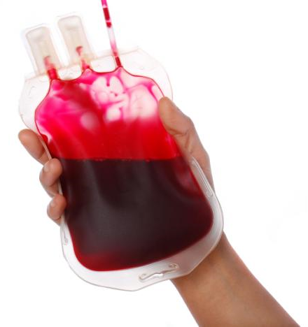
What is haematopoietic stem cell transplantation (HSCT)?
Formerly called bone marrow transplantation (BMT)
Involves intravenous (iv) infusion of haematopoietic stem cells to re-establish haematopoietic function in patients with a damaged or defective bone marrow or immune system
Patients with malignant cancers require HSCT to rescue their bone marrow from the toxic effects of high-dose chemotherapy
In non-malignant diseases, the goal of HSCT is to replace non-functional or failed marrow and immune system
Stem cells are usually derived from bone marrow, peripheral blood or umbilical cord blood
Haematopoiesis is the formation of blood cellular components
Over 40,000 HSCTs are carried out in Europe each year
Saria MG et al. Clin J Oncol Nurs 2007;11:53–63; Passweg JR et al. Bone Marrow Transplant 2016;51:786–92
HSCT, haematopoietic stem cell transplantation

Slide 7
HSCT is categorised by the donor source
Autologous
From the patient’s own bone marrow
Stem cell collection
High-dose chemotherapy and/or radiation to treat cancer
Rebuild immune system with collected cells
Patient
Patient
Side effect: Patient in haematopoietic failure
Patient with new haematopoietic system
Stem cell infusion
Allogeneic From another person, related or unrelated, who has been selected as suitably HLA-matched
Conditioning to eliminate patient’s immune system
Rebuild immune system with donor cells
Patient
Patient without immune system
Patient with new haematopoietic system
Stem cell collection
Stem cell infusion
Donor
Forman SJ, Nakamura R, Cancer Management: A Multidisciplinary Approach. Haller DG et. al. editors, 2015. Available at: http://www.cancernetwork.com/cancer-management/hematopoietic-cell-transplantation. Accessed March 2017; Saria MG et al. Clin J Oncol Nurs 2007;11:53–63
HLA, human leukocyte antigen;
HSCT, haematopoietic stem cell transplantation

Slide 8
Autologous versus allogeneic HSCT
 | Autologous transplantation | Allogeneic transplantation
% of all HSCTs | 57% | 43%
Main indications | Lymphomas, multiple myeloma, some solid tumours, autoimmune disorders | Leukaemias, lymphomas, non-malignant disorders (eg aplastic anaemia, sickle cell disease, autoimmune disorders)
Uses | To bridge haematopoietic failure during high-dose chemotherapy for treatment of tumours of the haematopoietic system | To replace the haematopoietic and immune system in patients with acquired or congenital failure and to exploit the graft-versus-cancer effect
Advantages | No risk of graft rejection | No risk of cancer cell contamination Donor cells may attack remaining cancer cells (graft-versus-cancer effect)
Disadvantages | Cancer cells may be harvested along with stem cells, leading to relapse Cancer cells may be able to evade immune system No graft-versus-cancer effect | Difficulty finding suitable donors Risk of graft rejection Donor cells may attack the patient’s body (GvHD) Increased risk of infection due to immunosuppression
Passweg JR et al. Bone Marrow Transplant 2016;51:786–92; Majhail NS et al. Biol Blood Marrow Transplant 2015;21:1863–9; Saria MG et al. Clin J Oncol Nurs 2007;11:53–63; Forman SJ, Nakamura R, Cancer Management: A Multidisciplinary Approach. Haller DG et. al. editors, 2015. Available at: http://www.cancernetwork.com/cancer-management/hematopoietic-cell-transplantation. Accessed March 2017
GvHD, graft-versus-host disease; HSCT, haematopoietic stem cell transplantation

Slide 9
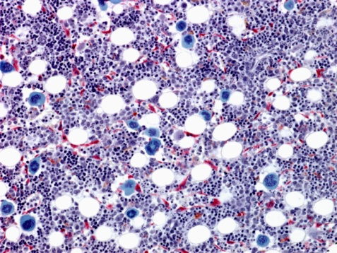
Conditioning is required for HSCT
Objectives of conditioning:
Autologous HSCT
Chemotherapy is administered at an effective dose to treat cancer, with the side effect of bone marrow toxicity, but preserving non-haematopoietic organ function
Allogeneic HSCT
Disease eradication
Immunosuppression to prevent GvHD (allogeneic HSCT)
‘Creation of space’ in the bone marrow to allow engraftment of donor cells
Prior to HSCT, patients receive conditioning regimens in the form of chemotherapy with or without radiotherapy
Histological section of the bone marrow
Saria MG et al. Clin J Oncol Nurs 2007;11:53–63; Passweg JR et al. Swiss Med Wkly 2012;142:13696; Gratwohl A, Carreras E. Principles of conditioning. In: Apperley J, Carreras E, Gluckman E, Masszi T eds. ESH-EBMT Handbook on Haematopoietic Stem Cell Transplantation. Genova: Forum Service Editore, 2012;122–37
GvHD, graft-versus-host disease; HSCT, haematopoietic stem cell transplantation

Slide 10
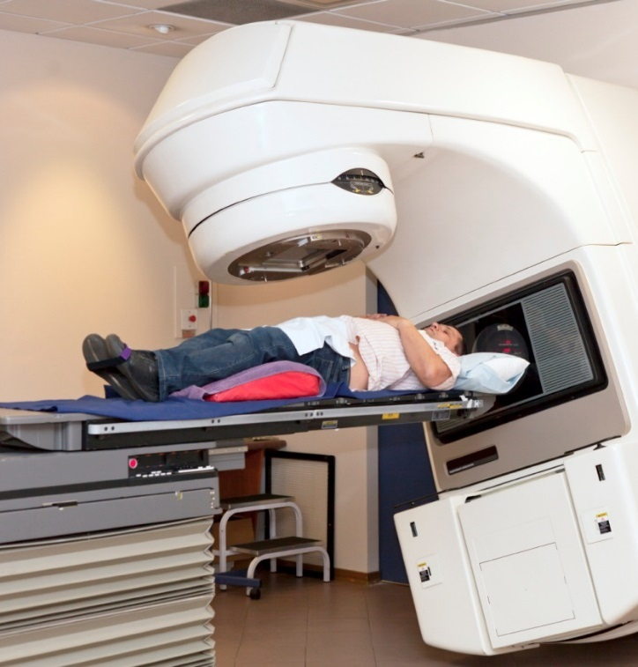
Types of conditioning regimens: myeloablative conditioning
Traditionally, myeloablative (high-dose) conditioning regimens were used for HSCT
Usually restricted to younger patients without comorbidities
These irreversibly destroy the bone marrow, preventing haematological recovery
Regimens include high-dose total body irradiation (TBI) and/or alkylating agents (eg busulfan, cyclophosphamide, etoposide, melphalan, cytarabine)
These regimens are associated with significant morbidity and transplant-related mortality (TRM)
In the last 20 years this has led to the development of the alternative regimens reduced-intensity (RIC) and non-myeloablative (NMA) conditioning
Patient receiving radiotherapy
Gyurkocza B, Sandmaier BM. Blood 2014;124:344–53; Shi M et al. Blood Lymphat Cancer 2013;3:1–9; Passweg JR et al. Swiss Med Wkly 2012;142:13696
HSCT, haematopoietic stem cell transplantation

Slide 11
Types of conditioning regimens: reduced intensity conditioning (RIC) and non-myeloablative (NMA) regimens
With these regimens, the goal is to promote disease eradication, promote engraftment, and exploit the graft-versus-cancer effect to eliminate the tumour cells
Non-myeloablative regimens | Reduced intensity conditioning
Cause minimal cytopenia Do not require stem cell support for haematopoietic recovery Regimens can include low-dose TBI, fludarabine and cyclophosphamide or cytarabine | Causes cytopenia of variable duration, which is usually reversible Requires stem cell support Dose of chemotherapy or TBI is reduced by ≥ 30% versus myeloablative conditioning Regimens can include low-doses of TBI, busulphan, melphalan or thiotepa, or fludarabine
Although these regimens limit toxicity, life-threatening complications, such as veno-occlusive disease (VOD), may still occur
Module 2 link
Dalle JH, Giralt SA. Biol Blood Marrow Transplant 2016;22:400–9; Bacigalupo A et al. Biol Blood Marrow Transplant 2009;15:1628–33
HSCT, haematopoietic stem cell transplantation; TBI, total body irradiation

Slide 12
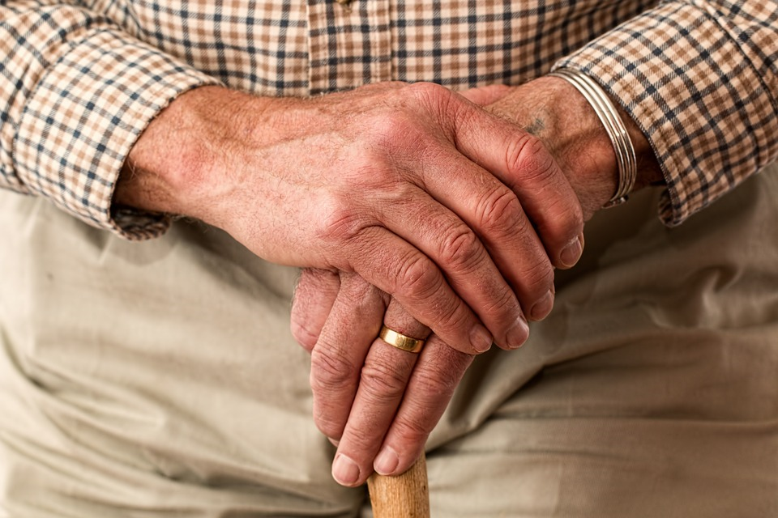
HSCT is now available to higher risk patients
RIC and NMA regimens have enabled patients who may have been unsuitable for myeloablative regimens to now undergo HSCT:
Older patients (>60 years)
Medically unfit patients
Patients with a high HCT comorbidity index
Heavily pre-treated patients
These patients are likely to have a higher potential for post-HSCT complications, such as VOD
The use of RIC and NMA regimens broadens HSCT eligibility to older and less medically fit patients
Module 2 link
Goyal G, et al. Ther Adv Hematol 2016;7:131–41; Dalle JH, Giralt SA. Biol Blood Marrow Transplant 2016;22:400–9
HCT, haematopoietic cell transplantation; HSCT, haematopoietic stem cell transplantation; NMA, non-myeloablative; RIC, reduced-intensity conditioning; VOD, veno-occlusive disease

Slide 13
HSCT is associated with multiple complications, mainly related to conditioning and immunosuppression
Pre-engraftment phase
Early post-engraftment
Late post-engraftment
Gram-positive bacteria
Gram-negative bacteria
Cytomegalovirus infections
Aspergillus, Candida
Varicella-zoster virus
Conditioning regimen toxicities
Engraftment syndrome
Acute graft-versus-host disease (GvHD)
Chronic GvHD
Hepatic veno-occlusive disease (VOD)
Diffuse alveolar haemorrhage
Bronchiolitis obliterans
Idiopathic pneumonia syndrome
Haemorrhagic cystitis
Haemorrhagic cardiomyopathy
Haemorrhagic cystitis
Acute renal failure
-1
1
2
3
4
5
8
12
16
20
(Day 0 = transplant)
(Day 30)
(Day 100)
Weeks after transplant
Chronology of haematopoietic stem cell transplant complications
Adapted from Saria MG et al. Clin J Oncol Nurs 2007;11:53–63
GvHD, graft-versus-host disease; HSCT, haematopoietic stem cell transplantation

Slide 14
Neutropenia, GvHD, infection and VOD are important complications requiring intervention
Complications associated with HSCT require prophylaxis or treatment:
Growth factors
(eg GCSF)
Neutropenia
Immunosuppressive drugs
(eg corticosteroids, cyclosporine)
GvHD
Antimicrobials
(eg antibiotics, antifungals, antivirals)
Infection
Defibrotide*
VOD
Module 4 link
Module 2 link
Saria MG et al. Clin J Oncol Nurs 2007;11:53–63; Masszi T, Mank A. Supportive Care. In: Apperley J, Carreras E, Gluckman E, Masszi T eds. ESH-EBMT Handbook on Haematopoietic Stem Cell Transplantation. Genova: Forum Service Editore, 2012;156–74; Dalle JH, Giralt SA. Biol Blood Marrow Transplant 2016;22:400–9
*Defibrotide is only licensed for the treatment of severe hepatic VOD in haematopoietic stem cell transplantation therapy.
GCSF, granulocyte colony-stimulating factor; GvHD, graft-versus-host disease; HSCT, haematopoietic stem cell transplantation; VOD, veno-occlusive disease

Slide 15
Immediate post-HSCT period requires supportive care
Several clinical problems that arise after HSCT frequently require supportive care
Impaired nutritional status
Impaired nutritional status
Negative prognostic factor
Enteral or parenteral feeding commonly administered prophylactically after HSCT
The most common complications of iv nutrition are related to the central venous catheter, eg infections, thromboembolism, obstruction, dislodgement and leakage
Mucositis
Associated with systemic infection risk
Patients should use a soft toothbrush
Many patients require specific care: mouthwashes, laser therapy and narcotic pain medication
Evidence supporting the benefit of mucosal coating agents is weak
Supportive care
Nausea
Continues to have a great impact on quality of life following chemotherapy conditioning
Most feared side effect
Serotonin receptor antagonists and dexamethasone are the standard prophylaxis
Masszi T, Mank A. Supportive Care. In: Apperley J, Carreras E, Gluckman E, Masszi T eds. ESH-EBMT Handbook on Haematopoietic Stem Cell Transplantation. Genova: Forum Service Editore, 2012;156–74; Flynn M. Chemotherapy induced nausea & vomiting: a nurse’s perspective. Available at: http://www.ebmt.org/Contents/Resources/Library/Slidebank/EBMT2013SlideBank/Documents/Nurses/N1239.pdf. Accessed March 2017
HSCT, haematopoietic stem cell transplantation; iv, intravenous

Slide 16
Summary of HSCT
Autologous HSCT uses stem cells derived from the patient’s own bone marrow; allogeneic HSCT uses stem cells from a related or unrelated donor
Autologous HSCT has no risk of rejection, however, cancer cells may be transplanted along with normal stem cells
Allogeneic HSCT may result in a beneficial graft-versus-cancer effect, but it carries a small risk of engraftment failure and GvHD
Conditioning prior to HSCT is required in order to eradicate the disease, prevent rejection, or aid engraftment
RIC/NMA regimens aim to reduce morbidity and mortality and have enabled older, less medically fit patients to undergo HSCT and haploidentical transplants to be carried out
HSCT and conditioning are associated with multiple complications, such as neutropenia, mucositis, nausea, infection and VOD, that require treatment and supportive care
GvHD, graft-versus-host disease; HSCT, haematopoietic stem cell transplantation; NMA, non-myeloablative; RIC, reduced-intensity conditioning; VOD, veno-occlusive disease

Slide 17
Self-assessment questions
Of the following, which is not a risk associated with autologous HSCT? Click on the answer that you think is correct
Harvesting of cancer cells
Graft-versus-host disease
Evasion of transplanted cells by the cancer
HSCT, haematopoietic stem cell transplantation
Notes:
Answers:
b) Graft-versus-host disease is not a risk of autologous HSCT

Slide 18
Self-assessment questions
Which of the following are objectives of conditioning regimens prior to allogeneic HSCT?
Disease eradication
Immunosuppression
‘Creation of space’ in the bone marrow
Click on the answers that you think are correct:
a and b
b and c
a, b and c
HSCT, haematopoietic stem cell transplantation
Notes:
Answers:
All of the above are objectives of conditioning:
Disease eradication
Immunosuppression to prevent GvHD (allogeneic HSCT)
‘Creation of space’ in the bone marrow to allow engraftment of donor cells

Slide 19
Self-assessment questions
Which of the following statements about non-myeloablative (NMA) and reduced-intensity conditioning (RIC) regimens are false?
The goal is to promote disease eradication, promote engraftment, and exploit the graft-versus-cancer effect to eliminate the tumour cells
They irreversibly destroy the bone marrow, preventing haematological recovery
They use low doses of total body irradiation and/or chemotherapy agents
They are generally restricted to medically fit patients under the age of 50 years
Click on the answers that you think are false:
a and c
b and d
b, c and d
HSCT, haematopoietic stem cell transplantation
Notes:
Answers:
Answers b and d are false. Myeloablative regimens irreversibly destroy the bone marrow, whereas reduced intensity conditioning (RIC) and non-myeloablative regimens are less aggressive, causing reversible or minimal cytopenia. Unlike myeloablative regimens, RIC and NMA regimens enable older and less medically fit patients to undergo HSCT.

Slide 20
Self-assessment questions
Reduced-intensity conditioning (RIC) and non-myeloablative (NMA) regimens remove the risk of life-threatening complications, such as veno-occlusive disease (VOD). True or false?
True
False
Notes:
Answers:
False. Although RIC and NMA regimens limit HSCT toxicity, life-threatening complications, such as veno-occlusive disease (VOD), may still occur.

Slide 21
Self-assessment questions
Immunosuppressive drugs, such as corticosteroids, are given in order to manage which HSCT-related condition?
Neutropenia
Graft-versus-host disease
Infection
HSCT, haematopoietic stem cell transplantation
Notes:
Answers:
b) Immunosuppressive drugs such as corticosteroids are given in order to manage graft-versus-host disease, in which an allogeneic graft attacks host tissue

Slide 22
Self-assessment questions
Of these three clinical problems arising after HSCT, which is most feared by patients?
Impaired nutritional status
Nausea
Mucositis
HSCT, haematopoietic stem cell transplantation
Notes:
Answers:
b) Nausea is most feared by patients, and has a significant impact on quality of life

Slide 23
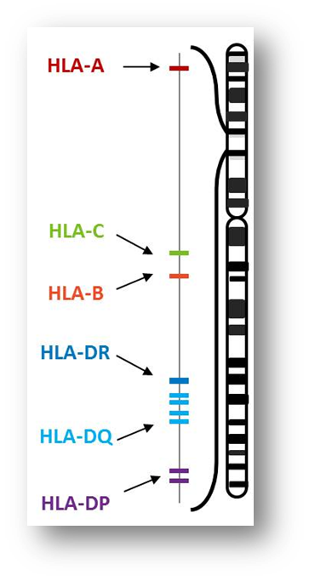
HLA compatibility in allogeneic HSCT
HLA proteins are found on all cells of our body and are the main way the immune system tells the difference between our own cells and foreign cells
HLA compatibility in HSCT is of greater importance than in organ transplantation, as rejection occurs not only in the host-versus-graft direction, but also as GvHD
Approximately 15–30% of patients referred for allogeneic HSCT have at least one suitable HLA-identical sibling donor
For patients without a suited family donor, a search for an HLA-matched unrelated donor is undertaken – this kind of donor is available for 30–70% of patients
For patients without a HLA-matched donor, using a half-matched (haploidentical) donor (eg a parent) is an option
Problems from incomplete matches include graft rejection, infection and disease relapse because of reduced graft-versus-host activity after depletion of donor lymphocytes and poor immune reconstitution
Passweg JR et al. Swiss Med Wkly 2012;142:w13696; Nowak J. Bone Marrow Transpl 2008;42:S71–6; Forman SJ, Nakamura R, Cancer Management: A Multidisciplinary Approach. Haller DG et. al. editors, 2015. Available at: http://www.cancernetwork.com/cancer-management/hematopoietic-cell-transplantation. Accessed March 2017
GvHD, graft-versus-host disease; HLA, human leukocyte antigen; HSCT, haematopoietic stem cell transplantation

Slide 24
Indications for HSCT
Autologous HSCT |  | Allogeneic HSCT
Acute myeloid leukaemia (AML) Acute promyelocyte leukaemia* Acute lymphoblastic leukaemia (ALL)* Multiple myeloma Plasma cell leukaemia Primary amyloidosis POEMS syndrome Hodgkin lymphoma* Diffuse large B-cell lymphoma* Follicular lymphoma* Mantle cell lymphoma* T-cell lymphoma* Lymphoplasmacytic lymphoma* | Burkitt's lymphoma* Cutaneous T-cell lymphoma* Chronic lymphocytic leukaemia (CLL)* Solid tumours (germ cell, Ewing’s sarcoma, brain tumours*) Multiple sclerosis† Rheumatoid arthritis† Systemic lupus erythematosus† Crohn's disease† Polymyositis-dermatomyositis† | Acute myeloid leukaemia (AML) Acute promyelocyte leukaemia Acute lymphoblastic leukaemia (ALL) Chronic myeloid leukaemia (CML) Myelodysplastic syndromes (MDS) Therapy-related AML/MDS Myelofibrosis and myeloproliferative diseases Multiple myeloma* Plasma cell leukaemia Hodgkin lymphoma* | Diffuse large B-cell lymphoma* Follicular lymphoma* Mantle cell lymphoma T-cell lymphoma* Lymphoplasmacytic lymphoma* Burkitt's lymphoma Cutaneous T-cell lymphoma Chronic lymphocytic leukaemia Severe aplastic anaemia Sickle cell disease Fanconi's anaemia Thalassaemia Metabolic diseases
Sureda A et al. Bone Marrow Transpl 2015;50:1037–56;
Majhail NS et al. Biol Blood Marrow Transplant 2015;21:1863–9
*Certain situations. †Developmental indication. This list is not exhaustive. HSCT, haematopoietic stem cell transplantation; POEMS, polyneuropathy, organomegaly,
endocrinopathy, monoclonal gammopathy and skin abnormalities

Slide 25
HSCT is associated with multiple complications
HSCT-related complications can be classified according to the time at which they occur:
Pre-engraftment, from Day 0–30 post-transplant
Early after engraftment, from Days 30–100 post-transplant
Late after engraftment, after >100 days post-transplant
HSCT-related complications may also be classified by cause:
Conditioning-related toxicity
Immunosuppression
Donor cell-mediated toxicity
Recipient cell-mediated toxicity
Relapse of underlying malignancy
Recipients of HSCT require close monitoring and sometimes advanced support
Saria MG et al. Clin J Oncol Nurs 2007;11:53–63
HSCT, haematopoietic stem cell transplantation

Slide 26
Neutropenia is an important complication requiring intervention
Conditioning regimens suppress the bone marrow, therefore white blood cell counts will drop
Growth factor is recommended to improve haematopoietic recovery time, lower infection rates, decrease length of hospital stay and potentially reduce treatment costs
Masszi T, Mank A. Supportive Care. In: Apperley J, Carreras E, Gluckman E, Masszi T eds. ESH-EBMT Handbook on Haematopoietic Stem Cell Transplantation. Genova: Forum Service Editore, 2012;156–74; Saria MG et al. Clin J Oncol Nurs 2007;11:53–63

Slide 27
GvHD is an important complication requiring intervention
Serious complication of allogeneic HSCT in which the donor immune cells attack the host tissue
Immunosuppressive therapy is given at a level to partially suppress immunity to prevent GvHD, but also to maximise benefit from graft-versus-cancer effect
Corticosteroids, cyclosporine, tacrolimus, mycophenolate mofetil, and methotrexate are the most commonly used immunosuppressants
Variation in formulations, bioavailability and therapeutic levels, combined with drug interactions, can cause increased toxicity
Masszi T, Mank A. Supportive Care. In: Apperley J, Carreras E, Gluckman E, Masszi T eds. ESH-EBMT Handbook on Haematopoietic Stem Cell Transplantation. Genova: Forum Service Editore, 2012;156–74; Saria MG et al. Clin J Oncol Nurs 2007;11:53–63
GvHD, graft-versus-host disease; HSCT, haematopoietic stem cell transplantation

Slide 28
Infection is an important complication requiring intervention
The immunocompromised state of a patient undergoing HSCT renders them susceptible to severe infection
Infections account for ~20% of deaths following HSCT, most of which occur in the first 100 days post-transplant
Prophylactic antibiotics can be administered for bacterial infections, which most commonly occur during the neutropenic phase after conditioning
Antifungals are used prophylactically (general prevention), empirically (eg for neutropenic patients with negative clinical/laboratory findings), and pre-emptively (eg for patients with a high risk of life-threatening disease prior to clinical recognition)
Prophylaxis against Pneumocystis carinii using trimethoprim/sulfamethoxazole or nebulised pentamidine is recommended for all allogeneic HSCT recipients. Prophylactic or pre-emptive agents are recommended for high-risk or positive individuals for viruses such as cytomegalovirus, Epstein–Barr virus, herpes simplex virus, varicella zoster virus, and respiratory viruses
Masszi T, Mank A. Supportive Care. In: Apperley J, Carreras E, Gluckman E, Masszi T eds. ESH-EBMT Handbook on Haematopoietic Stem Cell Transplantation. Genova: Forum Service Editore, 2012;156–74; Saria MG et al. Clin J Oncol Nurs 2007;11:53–63
HSCT, haematopoietic stem cell transplantation

Slide 29
VOD is an important complication requiring intervention
VOD, also known as sinusoidal obstruction syndrome (SOS), is a potentially life-threatening complication of HSCT
Mean incidence typically ranges from 10–15% in adults, with a higher incidence in paediatric patients (20─60% depending mainly on underlying condition)
VOD can occur after autologous or allogeneic HSCT, regardless of the underlying disease, stem cell source or type of pre-transplant conditioning
The conditioning regimens given before HSCT can result in the production of toxic metabolites by the hepatocytes in the liver, which trigger the activation, damage and inflammation of the endothelial cells that line the sinusoids (small capillary-like blood vessels found in the liver)
Severe VOD, typically characterised by multi-organ failure, has been associated with a mortality rate >80%
Defibrotide is the only treatment currently licenced for the treatment of severe hepatic VOD in HSCT therapy
Carreras E. Early complications after HSCT. In: Apperley J, Carreras E, Gluckman E, Masszi T eds. ESH-EBMT Handbook on Haematopoietic Stem Cell Transplantation. Genova: Forum Service Editore, 2012;156–74; Saria MG et al. Clin J Oncol Nurs 2007;11:53–63; Corbacioglu S et al. Bone Marrow Transplant; in press
HSCT, haematopoietic stem cell transplantation; VOD, veno-occlusive disease

Slide 30
Correct
Graft-versus-host disease is a complication associated with allogeneic HSCT and not autologous HSCT
HSCT, haematopoietic stem cell transplantation

Slide 31
Correct
The objectives of conditioning are disease eradication, immunosuppression to prevent GvHD, and ‘creation of space’ in the bone marrow to allow engraftment of donor cells
GvHD, graft-versus-host disease

Slide 32
Correct
Myeloablative regimens irreversibly destroy the bone marrow, whereas reduced intensity conditioning (RIC) and non-myeloablative (NMA) regimens are less aggressive, causing reversible or minimal cytopenia. Unlike myeloablative regimens, RIC and NMA regimens enable older and less medically fit patients to undergo HSCT
HSCT, haematopoietic stem cell transplantation

Slide 33
Correct
Although RIC and NMA regimens limit toxicity, life-threatening complications, such as veno-occlusive disease (VOD), may still occur
NMA, non-myeloablative; RIC, reduced intensity conditioning

Slide 34
Correct
Immunosuppressive drugs such as corticosteroids are given in order to manage graft-versus-host disease, in which an allogeneic graft attacks host tissue

Slide 35
Correct
Nausea is reportedly most feared by patients, and has a significant impact on quality of life

Slide 36
Incorrect
Please try again

