Slide 1
Immune Thrombocytopenia:
A Learning Programme for Nurses and Other Allied Healthcare Professionals

Slide 2
Module contents
Module # | Title | Contents
1 | Overview of immune thrombocytopenia | History; epidemiology; classification; consequences; pathophysiology
2 | Identifying ITP | Symptoms; diagnosis; causes; prognosis
3 | Managing patients with ITP | Guidelines; treatment options; managing adverse effects of treatment; special considerations; the role of the nurse; patient education
4 | Paediatric ITP patients | Characteristics and causes; management of paediatric ITP
5 | Patient considerations | Recommendations; diet and lifestyle advice; surgery and dentistry
6 | Quality of life | Factors affecting QoL; assessing QoL; improving QoL

Slide 3
MODULE 1: OVERVIEW OF IMMUNE THROMBOCYTOPENIA
The European Group for Blood and Marrow Transplantation

Slide 4
What is ITP and why is it a problem?
Immune thrombocytopenia (ITP) is a haematological autoimmune disorder
ITP is a result of damage to or reduced production of platelets (cell fragments in blood)
Platelets are involved in forming blood clots to stop bleeding from blood vessel damage
This means that patients with ITP are at serious risk of bleeding events

Slide 5
History of ITP: Key discoveries
First described in 1735 by Paul Gottlieb Werlhof
Splenectomy first used in 1916 to treat ITP successfully
ITP established as an autoimmune disorder in 1951
1. Nakhoul IN, et al. Clin Adv Hematol Oncol 2006;4(2):136-144. 2. Kaznelson P. Wien Klin Wochenschr 1916;29:1451-1454. 3. Harrington WJ, et al. J Lab Clin Med 1951;38(1):1-10.

Slide 6
Epidemiology
ITP affects both genders and people of all ages, although it presents more frequently in the elderly
~1 in 30,000 adults and 1 in 12,000 children are diagnosed with ITP each year
More than 20% of patients with ITP have other immune disorders or chronic infections
1. Terrell DR et al. Am J Hematol 2010;85(3):174-180. 2. Cines DB, Bussel JB. Blood 2005;106(7):2244-2251. 3. Schoonen WM, et al.. Br J Haematol 2009;145(2):235-244. 4. Abrahamson PE, et al. Eur J Haematol 2009;83:83-89. 5. Liebman HA. Preface. Hematol Oncol Clin N Am 2009;23:xi. 6. Cines DB, et al. Blood 2009;113(26):6511-6521.

Slide 7
Incidence of ITP by age group and gender
Schoonen WM, et al. Br J Haematol 2009;145(2):235-244. Image reproduced used with permission from Br J Haematol

Slide 8
Classification of ITP
Duration | Classification
< 3 months | Newly diagnosed
3 – 12 months | Persistent
> 12 months | Chronic
Provan D, et al. Blood 2009;115:168-86.

Slide 9
Consequences of ITP
ITP patients have increased risks of experiencing bruising and spontaneous bleeding
Patients with platelet counts < 30 x 10⁹/L are at increased risk of serious bleeding events
However, life-threatening bleeding is rare in patients with platelet counts > 10 x 10⁹/L
1. Cohen YC, et al. Arch Intern Med 2000;160(11):1630-1608. 2. Rodeghiero F, et al. Eur J Haematol 2009;84:160-168. 3. Cines DB, Blanchette VS. N Engl J Med 2002;346(13):995-1008. 4. Lacey JV, Penner JA. Semin Thromb Hemost 1977;3(3):160-174. 5. Cortelazzo S, et al. Blood 1991;77(1):31-33.

Slide 10
Platelet count and bruising / bleeding risk
Platelet count (x 10⁹/L) | Symptoms*
> 50 | None
30 – 50 | Excessive bruising with minor trauma
10 – 30 | Spontaneous petechiae or bruising
< 10 | At risk of internal bleeding
*NB: It is possible for more than one symptom to occur at a particular platelet count range
Cines DB, Blanchette VS. N Engl J Med 2002;346(13):995-1008.

Slide 11
Increased age carries a higher risk of severe or fatal bleeding in ITP patients
Cohen YC, et al. Arch Intern Med 2000;160(11):1630-1608. Figure adapted with permission from Arch Intern Med.

Slide 12
Pathophysiology of ITP
The trigger for production of autoantibodies against platelets is unknown
ITP was originally thought to be entirely the result of platelet destruction by autoantibodies
However, we now know that production of platelets in bone marrow is also suboptimal in patients with ITP
Megakaryocytes (platelets’ parent cells) can also be damaged by platelet autoantibodies, making them less productive
1. Kaushansky K. N Engl J Med 1998;339(11):746-754. 2. Kuter DJ, Gernsheimer TB. Hematol Oncol Clin N Am 2009;23(6):1193-1211. 3. McMillan R, et al. Blood 2004;103(4):1364-1369. 4. Provan D. Eur J Haematol 2009;82(Suppl 71):8-12.

Slide 13
Pathophysiology of ITP
Video supplied courtesy of Amgen.

Slide 14
Assessment question
Which of the following contribute to ITP?
T-cell-mediated platelet destruction
Autoantibody-mediated platelet destruction
Suboptimal bone marrow platelet production
Autoantibody-mediated megakaryocyte damage
All of the above

Slide 15
Answer
Which of the following contribute to ITP?
T-cell-mediated platelet destruction
Autoantibody-mediated platelet destruction
Suboptimal bone marrow platelet production
Autoantibody-mediated megakaryocyte damage
All of the above

Slide 16
MODULE 2: IDENTIFYING ITP
The European Group for Blood and Marrow Transplantation

Slide 17
Signs and symptoms of ITP
Signs and symptoms of ITP are highly variable; most patients present asymptomatically
Discovery often occurs via routine blood tests
Symptomatic patients can present with one or more of:
Petechiae or purpura
Unusual or easy bruising (haematoma)
Persistent bleeding symptoms from cuts or other injuries
Mucosal bleeding
Frequent or heavy nose bleeds (epistaxis)
Haemorrhage from any site (usually gingival or menorrhage in women)
1. Sarpatwari A, et al. 2010;95(7):1167-1175. 2. Provan D, et al. Blood 2009;115(2):168-186.

Slide 18
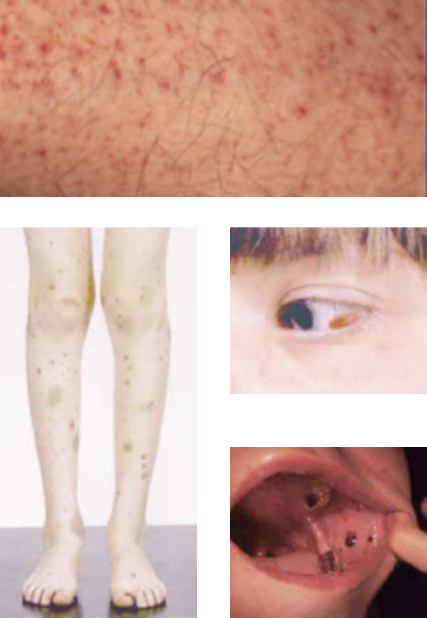
Examples of visible ITP symptoms
1
3
Petechiae
Purpura and haematoma
Conjunctival haemorrhage
Submucosal bleeding
2
4
Purpura and haematomas and conjunctival haemorrhage images courtesy of Douglas Cines and James Bussel. Mucosal bleeding and petechiae images courtesy of Drew Provan.

Slide 19
How is ITP diagnosed?
There is no standard test for ITP: diagnosis of ITP is usually made by exclusion
Diagnosis involves medical history, complete blood count, peripheral blood smear, and a physical examination
Drug history (including non-prescription drugs) should also be taken
Further tests are often needed to eliminate causes of secondary ITP (e.g. HIV)
1. Cines DB, Bussel JB. Blood 2005;106(7):2244-2251. 2. Cines DB, et al. Blood 2009;113(26):6511-6521. 3. Provan D, et al. Blood 2009;115(2):168-186. 4. Stevens W, et al. Neth J Med 2006;64(10):356-363.

Slide 20
Secondary causes of ITP
Cines DB, et al. Blood 2009;113(26):6511-6521. Image reproduced with permission from Blood.

Slide 21
Recommended diagnostic approaches for ITP
Basic evaluation | Tests of potential utility | Tests of unproven benefit
Patient history | Glycoprotein-specific antibody | Thrombopoeitin
Family history | Antinuclear antibodies | Reticulated platelets
Physical examination | Anti-thyroid antibodies and thyroid function | Bleeding time
Complete blood count and reticulocyte count | Pregnancy test in women of childbearing potential | Platelet-associated immunoglobulin G (PaIgG)
Bone marrow examination (selected patients) | Antiphospholipid antibodies (including anticardiolipin and lupus anticoagulant) | Platelet survival study
Quantitative immunoglobulin level measurement | Viral polymerase chain reaction (PCR) for parvovirus and cytomegalovirus (CMV) | Serum complement
Peripheral blood smear
Blood group (rhesus)
Direct antiglobulin test
Helicobacter pylori
Human immunodeficiency virus (HIV)
Hepatitis C virus (HCV)
Provan D, et al. Blood 2009;115(2):168-186. Table reproduced with permission from Blood

Slide 22
Prognosis
The outcome of ITP varies greatly from patient to patient
80% of children recover spontaneously, but chronic ITP is more frequent in adults
In patients responsive to therapy, mortality is similar to the general population, but non-responders are at higher risk
Patients with platelet counts < 30 x 10⁹/L are at increased risk of serious bleeding events
1. Mathias SD, et al. Health Qual Life Outcomes 2008;6:13. 2. British Committee for Standards in Haematology General Haematology Task Force. Br J Haematol 2003;120(4):574-596. 3. Portielje JE, et al. Blood 2001;97(9):2549-2554. 4. McMillan R, Durette C. Blood 2004;104(4):956-960. 5. Cohen YC, et al. Arch Intern Med 2000;160(11):1630-1608.

Slide 23
Assessment question
Which of the following tests are used as part of the basic evaluation for ITP diagnosis?
Helicobacter pylori test and peripheral blood smear
Thrombopoietin and reticulated platelet test
HIV test and family history
Physical examination and hepatitis C virus test
All of the above
1, 2 and 4
1, 3 and 4

Slide 24
Answer
Which of the following tests are used as part of the basic evaluation for ITP diagnosis?
Helicobacter pylori test and peripheral blood smear
Thrombopoietin and reticulated platelet test
HIV test and family history
Physical examination and hepatitis C virus test
All of the above
1, 2 and 4
1, 3 and 4

Slide 25
MODULE 3:
MANAGING PATIENTS WITH ITP
The European Group for Blood and Marrow Transplantation

Slide 26
The ITP Patient Journey
Video supplied courtesy of Amgen.

Slide 27
Treating ITP
Several ITP treatment guidelines exist, primarily based on expert opinion due to the lack of randomised controlled trials
Treatment choices are highly individualised and are affected by factors such as:
Therapy tolerance
Lifestyle
Comorbidities
Patients with platelet counts > 50 x 10⁹/L generally do not require treatment
Patients with platelet counts < 50 x 10⁹/L may require treatment depending on the symptoms they present and bleeding risk
1. Provan D, et al. Blood 2009;115(2):168-186. 2. British Committee for Standards in Haematology General Haematology Task Force. Br J Haematol 2003;120(4):574-596. 3. Neunert C, et al. Blood. 2011;117(16):4190-207.

Slide 28
Treatment guidelines
1. Provan D, et al. Blood 2010;115(2):168-186. 2. British Committee for Standards in Haematology General Haematology Task Force. Br J Haematol 2003;120(4):574-596. 3. Neunert C, et al. Blood. 2011;117(16):4190-207.

Slide 29
Deciding who and when to treat
Platelet count (x 10⁹/L) | Treatment
> 50 | No treatment
30 – 50 | No treatment, or prednisolone (1 – 1.5 mg/kg/day) for patients at higher risk of haemorrhage (e.g. hypertensive, concomitant medication use, head trauma, etc.)
< 30 | Prednisolone (0.5 – 2 mg/kg/day)
Haemorrhage or life-threatening bleed | Emergency treatment: Platelet transfusion Intravenous immunoglobulin (IVIg); 1 g/kg/day, 2 – 3 days Methylprednisolone (1 g/day, 3 days)
Stasi R. Eur J Haematol 2009;82(Suppl 71):13-19.

Slide 30
ITP therapies
First-line | Second-line | First- / second-line failure | Emergency
Corticosteroids | Immuno- suppressants | Thrombopoietin-receptor agonists | Vinca alkaloids
IVIg | Corticosteroid-sparing agents | *Combination chemotherapy* | Splenectomy
 | Monoclonal antibodies | *Autologous stem-cell transplantation* | Combination first-line therapies
 | Splenectomy | *Campath-1H* | Anti-fibrinolytics
 | Thrombopoietin-receptor agonists |  | Platelet transfusion (+ or - IVIg)
 | Vinca alkaloids
Asterisks denote that treatment option has minimal data and may present considerable toxicities
Treatment failure is considered to have occurred if no response is seen beyond a specific timeframe (e.g. >4 weeks with corticosteroids)
Provan D, et al. Blood 2009;115(2):168-186.

Slide 31
Therapy responses
Therapy | Initial response rate | Approximate time to response | Sustained response rate / duration
Corticosteroids | 70 – 95% | Days – weeks | 2 – 5 years in 80% of responders
IVIg | Up to 80% | Usually 2 – 4 days | Usually 2 – 4 weeks, can be months
Immuno- suppressants | 24 – 85% | Weeks – months | 25 – 50+%
Corticosteroid-sparing agents | 50 – 67% | Weeks - months | 46 – 67%
Monoclonal antibodies | 60% | 1 – 8 weeks | >3 – 5 years in 15 – 20% of responders
Splenectomy | ~80% | 1 – 24 days | ~65% for 5 – 10 years
Thrombopoietin-receptor agonists | 70 – 88% | 1 – 4 weeks | 1.5 – 4 years
Vinca alkaloids | 10 – 75% | 5 – 7 days | Average 10 months
Provan D, et al. Blood 2009;115(2):168-186.

Slide 32
Special considerations: Pregnancy
ITP should not present a problem for pregnancy, although factors such as platelet count must be considered
Platelet levels can decrease naturally by ~10% at the end of the third trimester
This usually has no effect and resolves by 2 months post-pregnancy, but may impact women with pre-existing ITP
Mild stable ITP usually does not need treatment, but treatment in women with symptomatic ITP varies with platelet count and haemorrhage risk
Regular monitoring is necessary throughout pregnancy (monthly for trimesters 1 and 2; fortnightly after 28 weeks; weekly after 36 weeks)
ITP may also first present during pregnancy
1. Provan D, et al. Blood 2009;115(2):168-186. 2. Stavrou E, McCrae KR. Hematol Oncol Clin N Am 2009;23(6):1299-1316.

Slide 33
Managing ITP through pregnancy
First-line treatment | Failing first-line treatment | Treatments to be avoided
Corticosteroids Low-dose prednisone (10–20 mg/day) | Combination of a corticosteroid and IVIg | Danazol
IVIg | Combination of IVIg with azathioprine | Immunosuppressants (except azathioprine)
 |  | Rituximab
 |  | Thrombopoietin receptor agonists
 |  | Vinca alkaloids
Provan D, et al. Blood 2009;115(2):168-186.

Slide 34
The nurse’s role in managing patients with ITP
Patient education
What ITP is
How ITP affects the patient
Treatment options and their benefits/side effects
Dosing, administration and duration of treatment
Managing side effects
Providing support
Enabling patients and their families to cope with the physiological and psychological effects of ITP

Slide 35
Patient education: At diagnosis
Educational opportunities
Give general overview of ITP Clarify the impact of the disease and overall prognosis Dispel common myths and reassure patients Advise on lifestyle considerations (e.g. activities to avoid) Review all treatment options particularly first-line options – benefits, side effects Give overview of routine laboratory assessments (e.g. platelet counts) Outline resources available to assist patients with psychosocial support

Slide 36
Patient education: Symptomatic disease
Educational opportunity
Describe dosing, administration and duration of treatment Assist with managing side effects of treatment Advise on second-line treatment options, particularly splenectomy Reduce risk of complications (e.g. detail what medicines to avoid) Give options for patients who have failed first- and second-line therapies Provide patients with details of who to contact for advice or in the event of bleeding occurring

Slide 37
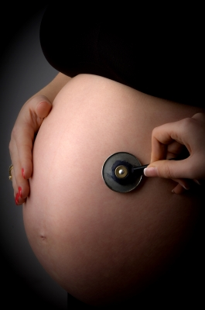
Patient education: Pregnancy
Educational opportunities
Detail any safety concerns for mother and foetus Explain outcomes of worsening maternal disease Describe risks of pregnancy itself

Slide 38
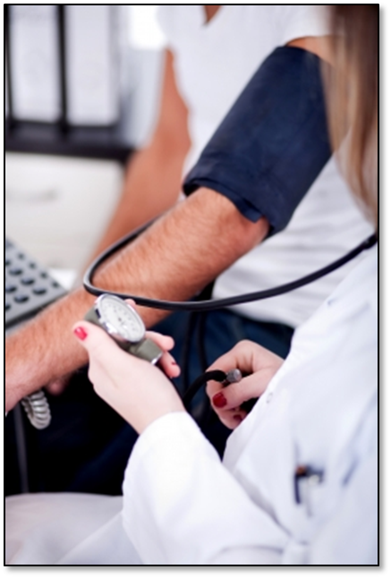
Patient education: Ongoing monitoring and follow-up
Educational opportunities
Provide appointment schedules Explain how to monitor signs and symptoms of falling platelet count Clarify when to seek medical attention Encourage patients to join a support group

Slide 39
Side effects of treatment
The various interventions used to treat ITP can present a range of side effects
It is essential that nurses are familiar with these effects so that they can be properly managed
It is also critical for patients to be made aware of these facts; nurses can play a key role in making patients aware of adverse events and mitigating strategies
Nurses should be prepared to discuss patients’ concerns related to treatment and its side effects

Slide 40
Managing adverse effects of treatment
Treatment | Side effect(s) | Management option(s)
Corticosteroids | Weight gain | Avoid high-fat and high-sugar foods Eat complex carbohydrates
 | Muscle loss | Maintain exercise
 | Gastrointestinal | Administer early in the day after food Proton pump inhibitors may be required
 | Oedema | Diuretics should only be administered on the advice of a physician Avoid excess dietary salt Wear compression stockings
 | Fatigue | Manage activities carefully Manage administration timing – give either early morning or late at night Ensure patient has enough sleep
 | Hyperglycaemia/ diabetes | Modify diet: avoid carbohydrates and sugars Regular monitoring of blood glucose levels Oral hypoglycaemic or subcutaneous insulin may be required
 | Acneiform rash | Use non-irritating soaps Topical or oral antibiotics may need to be prescribed
 | Immunosuppression | Monitor for infections Educate patients to report signs and symptoms
 | Other | Advise patients of possible mood changes Check blood pressure Monitor for signs of osteoporosis
Recommendations based on expert opinion

Slide 41
Managing adverse effects of treatment (continued)
Treatment | Side effect(s) | Management option(s)
IVIg | Infusion reactions | Slow rate of infusion, particularly first two occasions Advise patients of possible allergic reactions
 | Headaches | Increase fluid intake during treatment
Immunosuppressants | Immunosuppression | Monitor for infections Educate patients to report signs and symptoms
 | Liver function disturbances (for azathioprine) | Monitor liver enzymes weekly for first 8 weeks and then monthly
 | Bone marrow suppression (for azathioprine) | Monitor thiopurine methyltransferase levels
Splenectomy | Infections | Antibiotics may need to be prescribed Vaccinations pre-splenectomy and every 5 years thereafter against pneumococci and haemophilus If travelling abroad ensure immunisations are up- to-date
Thrombopoietin receptor agonists | Headaches | Use paracetamol rather than aspirin or anti-inflammatory agents as these can interfere with platelet function
Recommendations based on expert opinion

Slide 42
Assessment question
Which of the following treatments should not be used when treating pregnant ITP patients?
Rituximab
Corticosteroids
Thrombopoeitin receptor agonists
IVIg
All of the above
1 and 2
1 and 3
3 and 4

Slide 43
Answer
Which of the following treatments should not be used when treating pregnant ITP patients?
Rituximab
Corticosteroids
Thrombopoeitin receptor agonists
IVIg
All of the above
1 and 2
1 and 3
3 and 4

Slide 44
MODULE 4:
PAEDIATRIC ITP PATIENTS
The European Group for Blood and Marrow Transplantation

Slide 45
How does paediatric ITP differ from adult ITP?
Incidence rate | ~1 in 12,000 | ~1 in 30,000
Course | 85% acute / 15% chronic | Usually chronic
Triggers | Vaccinations and infections | Some reports of association with autoimmune disorders and pregnancy
Terrell DR, et al. Am J Hematol 2010;85(3):174-180. 2. Indiana Hemophilia and Thrombosis Center. Blood Type. Spring 2010.

Slide 46
Incidence rate of ITP by age in children
Kühne T, et al. Lancet 2001;358:2122–25.

Slide 47
Management of paediatric ITP: Acute ITP
More than 65% of cases of acute paediatric ITP resolve within 6 months without need for ongoing platelet-enhancing therapy
Acute paediatric ITP should be treated based on symptoms, not just platelet count
Intervention in acute ITP should therefore be reserved for children with:
Overt haemorrhaging and low platelet count (<20 x 10⁹/L)
Organ- or life-threatening bleeding, irrespective of platelet count
Effective therapeutic options include corticosteroids and IVIg
Blanchette V and Bolton-Maggs P. Pediatr Clin N Am 2008;55:393–420.

Slide 48
Management of paediatric ITP: Chronic ITP
Children with ITP persisting >6 months usually require no therapy when platelet count is 30 – 150 x 10⁹/L
The subgroup with platelet counts <20 x 10⁹/L and bleeding risk may require therapy:
Medical management with corticosteroids and IVIg is appropriate for ITP lasting <12 months
2nd-line therapies (e.g. rituximab) can be used if ITP is still present 18 months post-diagnosis
Splenectomy is only advocated in ASH guidelines for a very small subset of paediatric ITP patients, specifically those with:
Platelet count <10 x 10⁹/L (ages 3 – 12) or 10 – 30 x 10⁹/L (ages 8 – 12)
Bleeding risk
ITP persisting at 12 months since initial presentation
Blanchette V and Bolton-Maggs P. Pediatr Clin N Am 2008;55:393–420

Slide 49
Assessment question
What percentage of paediatric ITP patients spontaneously recover within ~1 year?
15%
85%
25%
75%
65%

Slide 50
Answer
What percentage of paediatric ITP patients spontaneously recover within ~1 year?
15%
85%
25%
75%
65%

Slide 51
MODULE 5:
PATIENT CONSIDERATIONS
The European Group for Blood and Marrow Transplantation

Slide 52
Living with ITP
ITP is manageable; next slides show steps that patients can take to prevent complications
The goal of treatment is to attain a haemostatically safe platelet count (>50 x 10⁹/L)
This can be aided by relatively minor adjustments to activities in daily life that can impact on platelet count
1. Platelet Disorder Support Association. Living with ITP. http://pdsa.org/images/stories/pdf/living_with_itp122010.pdf 2. Provan D, et al. Blood 2009;115(2):168-186.

Slide 53
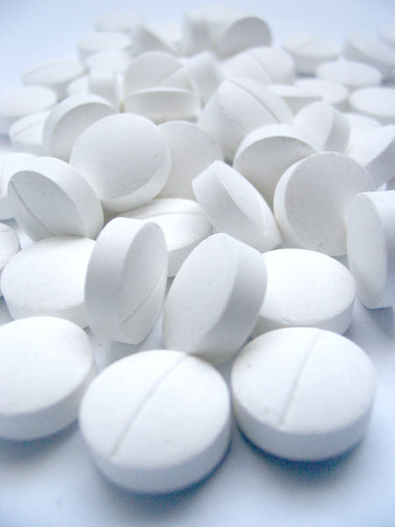
Patient recommendations: Medications
Recommendation
Avoid medicines that affect platelet function: Blood-thinning pharmaceuticals (e.g. aspirin, warfarin) Anti-inflammatory agents (e.g. ibuprofen, naproxen) Platelet aggregation inhibitors (e.g. glycerol guaiacolate) Use paracetamol-containing medications for pain or fever; if aspirin, NSAIDS, warfarin or other anti-thrombotics are essential, maintain platelet counts at 40 – 50 x 10⁹/L
Recommendations based on expert opinion

Slide 54
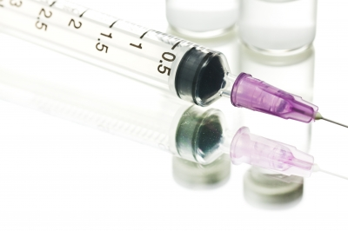
Patient recommendations: Vaccinations
Recommendation
Some live attenuated vaccines (e.g. MMR) have been associated with onset of ITP However, the effect is usually mild and short-lived Vaccination efficacy can be impacted by some therapies (e.g. rituximab can affect the pneumoccocal, meningococcal and influenza B triple vaccine) For patients scheduled to undergo splenectomy, vaccines such as the one above should be given 6 weeks prior to surgery
1. Provan D, et al. Blood 2009;115(2):168-186.

Slide 55
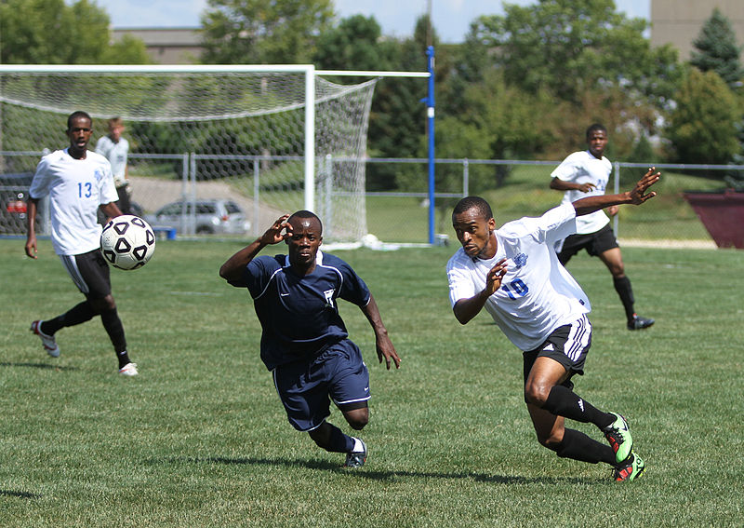
Patient recommendations: Activities
Recommendation
Most activities can be undertaken, although increased caution is required with lower platelet counts: Sexual activity is not restricted Patients may wish to limit participation in sports where there is a high risk of injury, particularly to the head and neck Care should be taken when working with knives or other tools For children, provide soft surfaces in play areas
Recommendations based on expert opinion

Slide 56
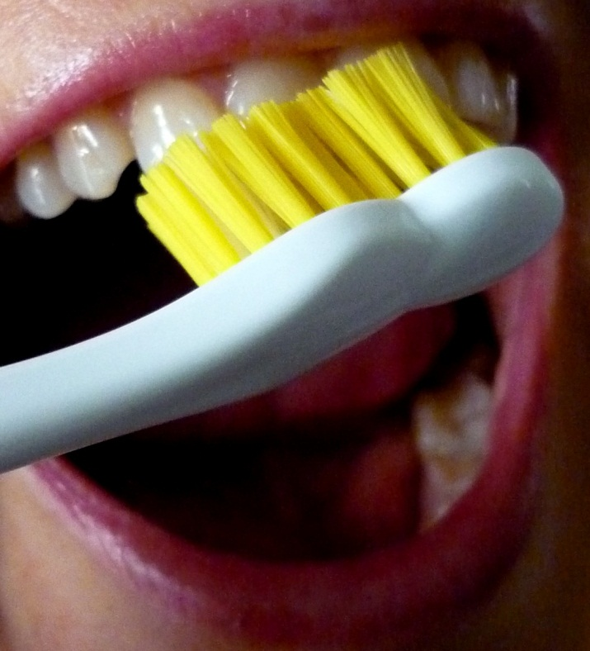
Patient recommendations: Personal hygiene
Recommendation
Brush teeth with a soft toothbrush Avoid dental flossing when platelet count < 50 x 10⁹/L Visit dentist regularly to avoid bleeding gums and gum disease Use an electric shaver rather than a razor for shaving
Recommendations based on expert opinion

Slide 57
Patient recommendations: Travel
Recommendation
Ensure patient has adequate travel insurance. If flying: Undertake the recommended in-flight exercises for preventing deep vein thrombosis (DVT) Wear support stockings Avoid alcohol and drink plenty of water Patients are advised to avoid traveling to areas with inadequate medical care
Recommendations based on expert opinion

Slide 58
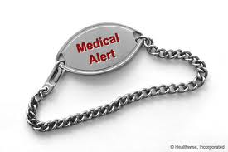
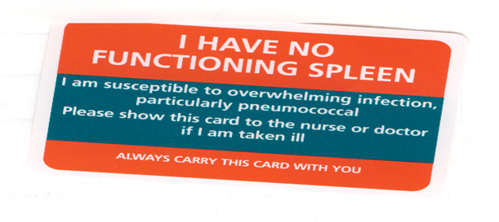
Patient recommendations: Other
Recommendation
Patients should wear a medical identification tag or bracelet to alert healthcare professionals to their condition in case of emergency, particularly if they have undergone a splenectomy Patients should also carry an identification or health card that states their illness and lists their medications and dosages
Recommendations based on expert opinion

Slide 59
Diet / lifestyle and ITP
It is important for ITP patients to maintain a healthy lifestyle and balanced diet
Additionally, it is important to moderate alcohol, tobacco and caffeine intake
Patients should be encouraged to keep a diary to determine if there are any connections between diet / lifestyle factors and their platelet count
Platelet Disorder Support Association. Living with ITP. Available at: http://pdsa.org/images/stories/pdf/living_with_itp122010.pdf

Slide 60
Surgery and dentistry
Surgical and dental procedures may pose a problem for some ITP patients
In general, more serious procedures pose a greater degree of bleeding risk
Platelet count should be assessed to establish whether it is appropriate for the patient to undertake the procedure
1. Provan D, et al. Blood 2009;115(2):168-186. 2. Stasi R. Eur J Haematol 2009;82(Suppl 71):13-19.

Slide 61
Recommended platelet counts for dental and surgical procedures
Procedure | Platelet count (x 10⁹/L)
Dentistry | ≥ 20
Tooth extractions Simple Complex | ≥ 30 ≥ 50
Local anaesthesia | ≥ 30
Minor surgery | ≥ 50
Major surgery | ≥ 80
Major neurosurgery | ≥ 100
1. Provan D, et al. Blood 2009;115(2):168-186. 2. Stasi R. Eur J Haematol 2009;82(Suppl 71):13-19.

Slide 62
Assessment question
Which of the following drugs can affect platelet function?
Warfarin
Ibuprofen
Aspirin
1 and 2
1 and 3
1, 2 and 3

Slide 63
Answer
Which of the following drugs can affect platelet function?
Warfarin
Ibuprofen
Aspirin
1 and 2
1 and 3
1, 2 and 3

Slide 64
MODULE 6: QUALITY OF LIFE
The European Group for Blood and Marrow Transplantation

Slide 65
Many factors affect quality of life (QoL) in ITP
Treatment side effects
Treatment
Emotional health
Functional health
Health-related QoL in ITP
Decreased platelet count
Social and leisure
Reproductive health
Symptoms
Work

Slide 66
Assessing QoL
A range of methods exist for assessing QoL in ITP:
General QoL survey forms such as the SF-36 questionnaire (right)
ITP-specific questionnaires e.g. the 50-question ITP Patient Assessment Questionnaire (ITP-PAQ)
Paediatric HRQoL metrics are also available, such as the Kids’ ITP Tools (KIT)
1. Ware JE. Spine 2000;25(24):3130–3139 2. Mathias SD, et al. Health and Quality of Life Outcomes 2007;5:11. 3. Klaasen RJ, et al. J Paediatr. 2007;150(5):510-5, 515.e1.

Slide 67
CASE STUDIES
The European Group for Blood and Marrow Transplantation

Slide 68
Case studies: Overview
A series of 4 patients with ITP will be presented; you will be provided with key background information:
Age
Time since diagnosis
Platelet count
Therapies received and treatment outcomes
Lifestyle considerations
Other medical conditions
In each case you should consider how the following may impact your answers to the questions in each case study:
Patient characteristics
The type of treatment and whether it is 1st-line, 2nd-line etc.
The patient’s lifestyle and dietary choices
What resources are available for support, and plans for follow-up

Slide 69
Case Study 1
Details
23-year-old male, first diagnosed aged 12 years
Initially presented with chronic ITP with persistently low platelet count (< 10 x 10⁹/L)
Has received no active ITP treatment at own / parents’ wishes
Has undergone a splenectomy on the advice of a haematologist; this resulted in stabilisation of platelet count at 150 x 10⁹/L
Lifestyle
Drinks a moderate amount of alcohol (~10 units/week); non-smoker; drinks 6 – 7 cups of coffee per day; enjoys an active lifestyle, and is a keen rugby player
What impact may the lack of a spleen have on the patient?
Are there any concerns about the patient playing rugby?
Should he make any adjustments to his diet?

Slide 70
Case Study 2
Details
26-year-old female first diagnosed 6 years ago
Chronic cyclical ITP presenting with sudden drops in platelet count and bleeding
Intolerant to corticosteroids; following discontinuation of steroids and immunoglobulins, has been receiving romiplostim (2 μg/kg weekly)
Lifestyle
Smokes 5 – 10 cigarettes per day; drinks 15 units of alcohol per week; does yoga for one hour per week; plans to start a family in the near future
What impact may her medication have (e.g. adverse effects)?
Advise the patient on recommended lifestyle adjustments
What issues might the patient need to be aware of in advance of becoming pregnant?

Slide 71
Case Study 3
Details
45-year-old male first diagnosed 10 years ago
Also suffers from chronic lymphocytic leukaemia (CLC); platelet count of < 30 x 10⁹/L
Has failed several first- and second-line therapies, including steroids and immunoglobulins; has undergone splenectomy, and is currently being prescribed romiplostim after another relapse
Lifestyle
Heavy smoker (25 – 30 cigarettes per day); heavy drinker (35 – 40 units per week); does not take exercise regularly; drinks 4 – 5 cups of coffee per day
What effect may ITP have on the outcome of the patient’s CLC?
The patient’s lifestyle is extremely unhealthy; set out a plan for him to improve his diet and lifestyle over the next 2 – 3 months

Slide 72
Case Study 4
Details
55-year-old female diagnosed with ITP 5 years ago
Had no outward symptoms (e.g. bleeding), but a routine blood test revealed a platelet count of < 30 x 10⁹/L
Received corticosteroids in the past, boosting platelet count to 70 x 10⁹/L; relapse occurred following discontinuation
Lifestyle
Non-smoker; does not drink alcohol or coffee; walks for ~1.5 hours most weekends; travels abroad frequently
What are the most likely therapy options this patient may be prescribed next by her physician?
What risks are most commonly associated with low platelet counts?
The patient is a keen traveller; what are the main factors should she consider when choosing her travel destinations?

Slide 73
APPENDIX
The European Group for Blood and Marrow Transplantation

Slide 74
Glossary
Term | Definition | Term | Definition
Antibodies | Proteins produced by the immune system that attack foreign antigens (e.g. bacteria, viruses) | Idiopathic | A disease of unknown cause
Autoimmune disorder | The body’s immune system reacts against its own tissue to produce antibodies that attack itself | Immune thrombocytopenia | A blood disease in which platelets are destroyed by the immune system and platelet production is inhibited
Bone marrow | Tissue inside of bones that produces blood cells | Immunosuppressants | Medicines that act to reduce the activity of the immune system
Bone marrow aspiration | Extraction of bone marrow from bones, usually the posterior iliac crest, using an aspiration needle | Intracranial haemorrhage | Bleeding that occurs in the skull as a result of either a ruptured or leaking blood vessel
Complete blood count | A measure of the number of blood cells including platelets | Megakaryocyte | A bone marrow cell that produces platelets
Corticosteroids | Medicines that act on the immune system | Menorrhagia | Abnormally heavy and prolonged menstrual bleeding
Haematoma | Raised purple areas (bruise) on the skin caused by blood collecting under the skin | Monoclonal antibody | An antibody produced from a single clone of cells

Slide 75
Glossary (continued)
Term | Definition | Term | Definition
Peripheral blood smear | A blood drop on a glass slide used to examine blood cells under the microscope | Reticulin | A network-forming fibre that acts to support soft tissues such as the bone marrow
Petechiae | A type of bleeding in the skin. Tiny red or purple dots (<3 mm in diameter) on the skin caused by broken blood vessels that can resemble a rash | Spleen | An organ that is part of the immune system, which filters and stores blood cells. Normally weighs 150 g and is located under the left costal margin
Plasma | The yellow liquid component of blood in which blood cells are suspended | Splenectomy | Surgery to remove the spleen
Platelet count | A measure of the number of platelets contained in the blood | Thrombocytopenia | Low platelet count (<100 x 10⁹/L)
Platelet | The small cells that form blood clots when blood vessels are damaged. Otherwise known as thrombocytes | Thrombopoietin | A protein produced at a fixed rate in the liver that is the key regulator of platelet production
Purpura | A type of haematoma. Purple bruises about 1 cm in diameter that are generally round in shape and caused by bleeding under the skin | Thrombopoietin receptor agonists | Medicines that mimic the action of endogenous thrombopoietin to stimulate the production of platelets

Slide 76
Additional ITP resources
Term | Definition
American Society of Hematology | www.hematology.org/
European Hematology Association (EHA) | www.ehaweb.org
European Society for Immunodeficiencies (ESID) | www.esid.org
International Patient Organisation for Primary Immunodeficiencies (IPOPI) | www.ipopi.org
ITP Foundation | www.itpfoundation.org
ITP Support Association | www.itpsupport.org.uk
ITP Village | www.ITPVillage.com
Platelet Disorder Support Association | www.pdsa.org
Platelets on the Web | www.ouhsc.edu/platelets/index.html
The Daily Strength | www.dailystrength.org/c/ Thrombocytopenic-Purpura/support-group
UK ITP Registry (adult) | http://www.ukitpregistry.com/
UK ITP Registry (paediatric) | http://www.uk-itp.org/

Slide 77
Guidelines references
British Committee for Standards in Haematology General Haematology Task Force. Guidelines for the investigation and management of idiopathic thrombocytopenic purpura in adults, children and in pregnancy. Br J Haematol 2003;120(4):574 – 596
Provan D, et al. International consensus report on the investigation and management of primary immune thrombocytopaenia. Blood 2010;115(2):168 – 186.
Neunert C, et al. The American Society of Hematology evidence-based practice guideline for immune thrombocytopenia. Blood 2011;117(16):4190 – 207.

Slide 78
Acknowledgements
The Nurses Group of the European Group for Blood and Marrow Transplantation gratefully acknowledges:
Erik Aerts (RN) Switzerland
Lorraine Derbyshire (RN) United Kingdom
Fiona Dooley (RN) United Kingdom
Mary Kelly (RN) Ireland
Willy Struijk (RN) The Netherlands
Louise Taylor (RN) United Kingdom
Catherina Trappmann (RN) Germany
Drew Provan (MD) United Kingdom
for their contributions to the development of the programme.
Date of preparation: 03.2013.
Copyright® 2013, The Nurses Group of the European Group for Blood and Marrow Transplantation
All rights reserved

Slide 79
Acknowledgements
The ITP Learning Programme was made possible by an educational grant from Amgen Europe

