Slide 1
EBMT Activity Survey
on HCT 2022 689 Teams 41 854 Patients 46 143 Transplants 54 Countries
If you wish to reuse these slides for internal/external presentation,
please contact the EBMT Activity Survey Office: activitysurvey@ebmt.org

Slide 2
EBMT Activity Survey in 2022: Patient and transplant numbers
Indication | Allogeneic HCT | Autologous HCT | Total
1st allo/1st auto HCT | 17,862 | 23,992 | 41,854
Additional HCT | 1,149 | 3,140 | 4,289
Total all transplants | 19,011 | 27,132 | 46,143
Teams: 689 | Countries reporting: 54

Slide 3
EBMT Activity Survey in 2022: Donor type and stem cell source: all transplants
Donor type | BM | PBSC | Cord | Total
HLA-id sibling | 1,277 | 3,791 | 21 | 5,089
Haplo-identical | 636 | 2,844 | n.a. | 3,480
Other family | 85 | 176 | 2 | 263
Syngeneic | n.a. | n.a. | n.a. | 16
Unrelated | 977 | 8,936 | 250 | 10,163
Allogeneic | 2,975 | 15,763* | 273 | 1,9011
Autologous | 33 | 27,096 | 3 | 27,132
* Includes 13 syngeneic HCT

Slide 4
EBMT Activity Survey in 2022: Main indications
Indication | Allogeneic 1st HCT | Autologous 1st HCT | Total
Myeloid (AML, CML, MDS/MPN) | 10,433 | 208 | 10,641
Lymphoid (ALL, CLL, HL, NHL) | 4,487 | 7,944 | 12,431
Plasma cell disorder | 187 | 13,694 | 13,881
Solid tumor | 28 | 1593 | 1621
Non-malignant disorders (all) | 2,572 | 478 | 3,050
bone marrow failure | 1,065 | 0 | 1,065
auto immune disease | 29 | 464 | 490
Other | 155 | 75 | 230
Total | 17,862 | 23,992 | 41,854

Slide 5
EBMT Activity Survey in 2022 Lymphoid neoplasia
Indication | Allogeneic 1st HCT | Autologous 1st HCT | Total
PCD - Myeloma | 161 | 13,270 | 13,431
PCD - Other | 26 | 424 | 450
HD | 348 | 2,218 | 2,566
NHL | 931 | 5,679 | 6,610

Slide 6
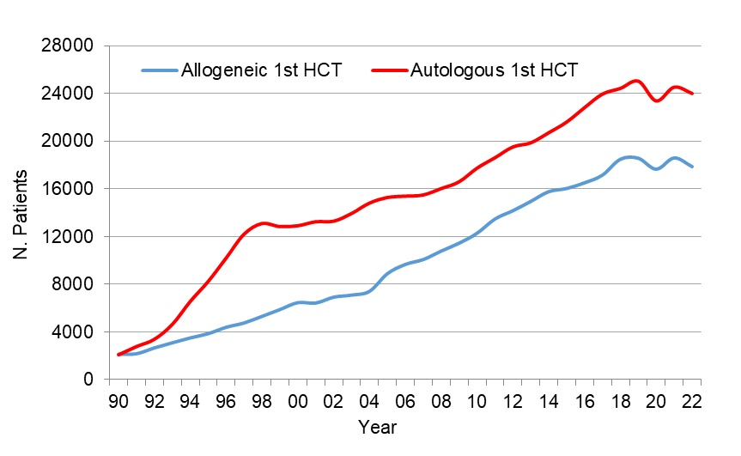
HCT activity in Europe 1990-2022: allogeneic vs autologous HCT
Passweg, Baldomero et al. Bone Marrow Transplant. (2024) 59:803–812

Slide 7
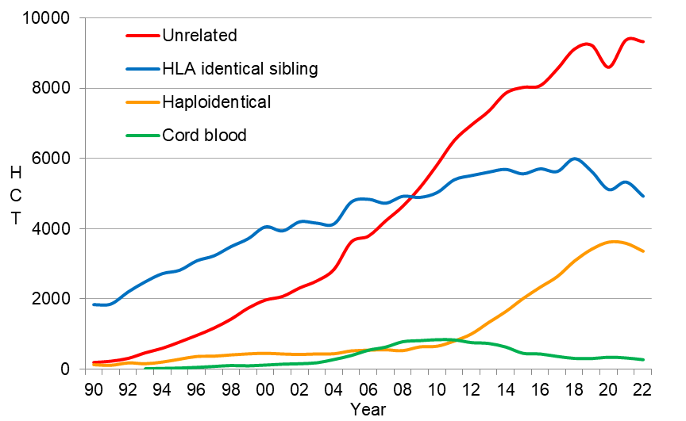
HCT activity in Europe 1990-2022: donor origin: 1st HCT
Passweg, Baldomero et al. Bone Marrow Transplant. (2024) 59:803–812

Slide 8
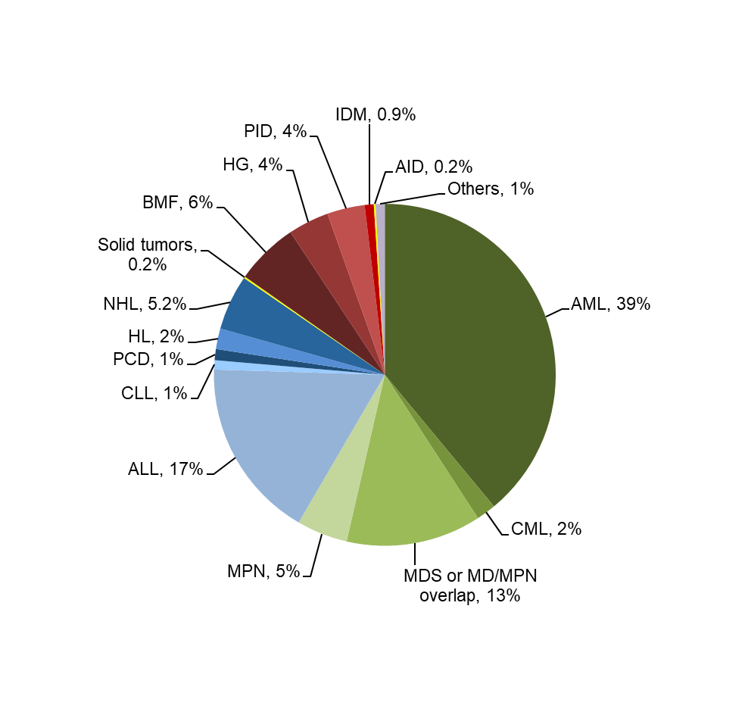
Allogeneic HCT in Europe 2022: 1st HCT
Passweg, Baldomero et al. Bone Marrow Transplant. (2024) 59:803–812

Slide 9
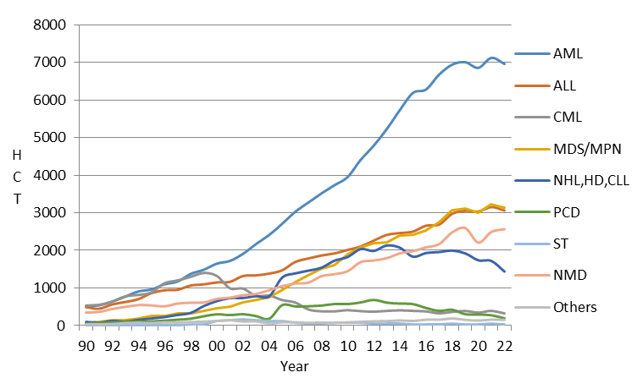
HCT activity in Europe 1990-2022: main indication: allogeneic 1st HCT

Slide 10
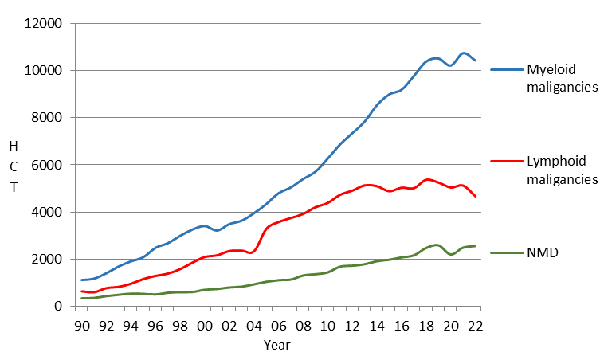
HCT activity in Europe 1990-2022: myeloid disorders: allogeneic 1st HCT

Slide 11
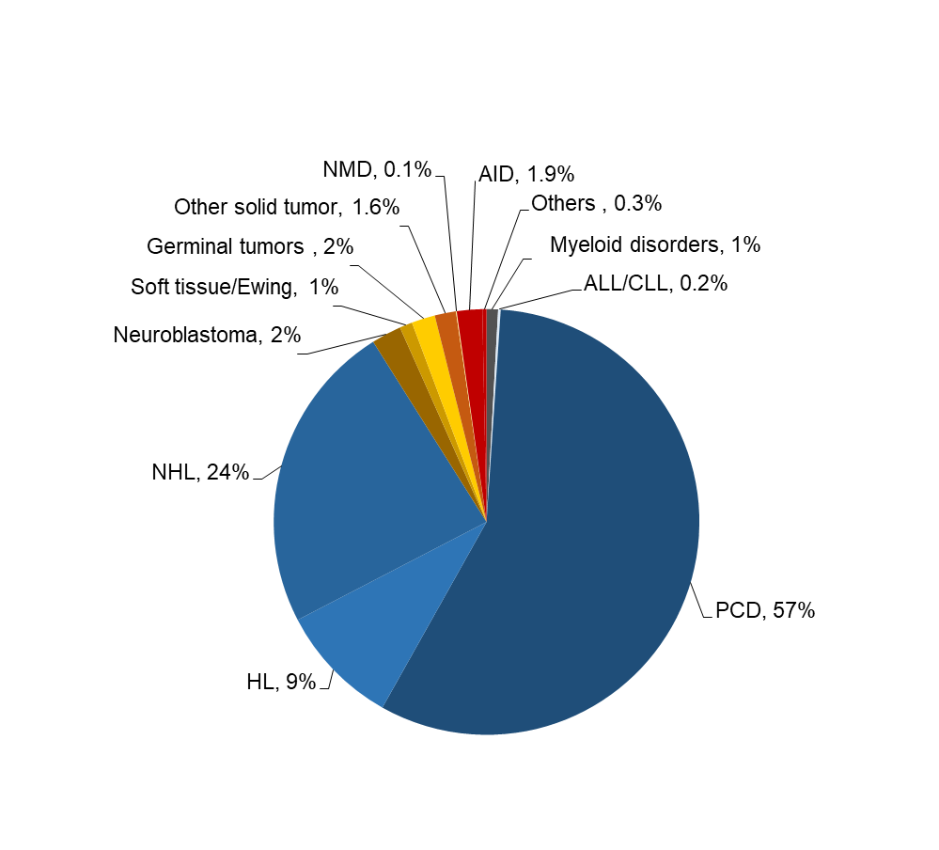
Autologous HCT in Europe 2022: 1st HCT
Passweg, Baldomero et al. Bone Marrow Transplant. (2024) 59:803–812

Slide 12
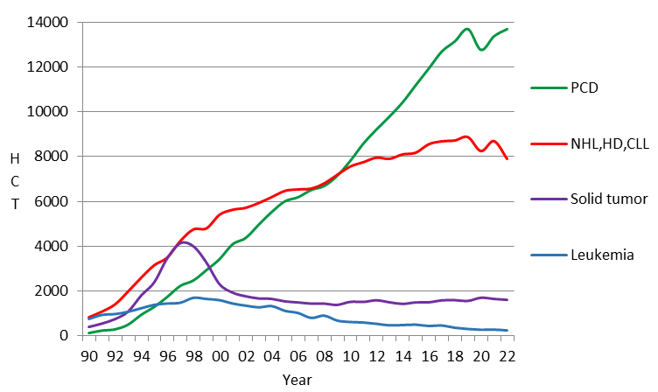
HCT activity in Europe 1990-2022: main indication: autologous 1st HCT

Slide 13
HCT activity in Europe 1990-2022: Changes in Myeloma and NHL HCT
Allogeneic 1st HCT
Autologous 1st HCT
Passweg, Baldomero et al. Bone Marrow Transplant. (2024) 59:803–812

Slide 14
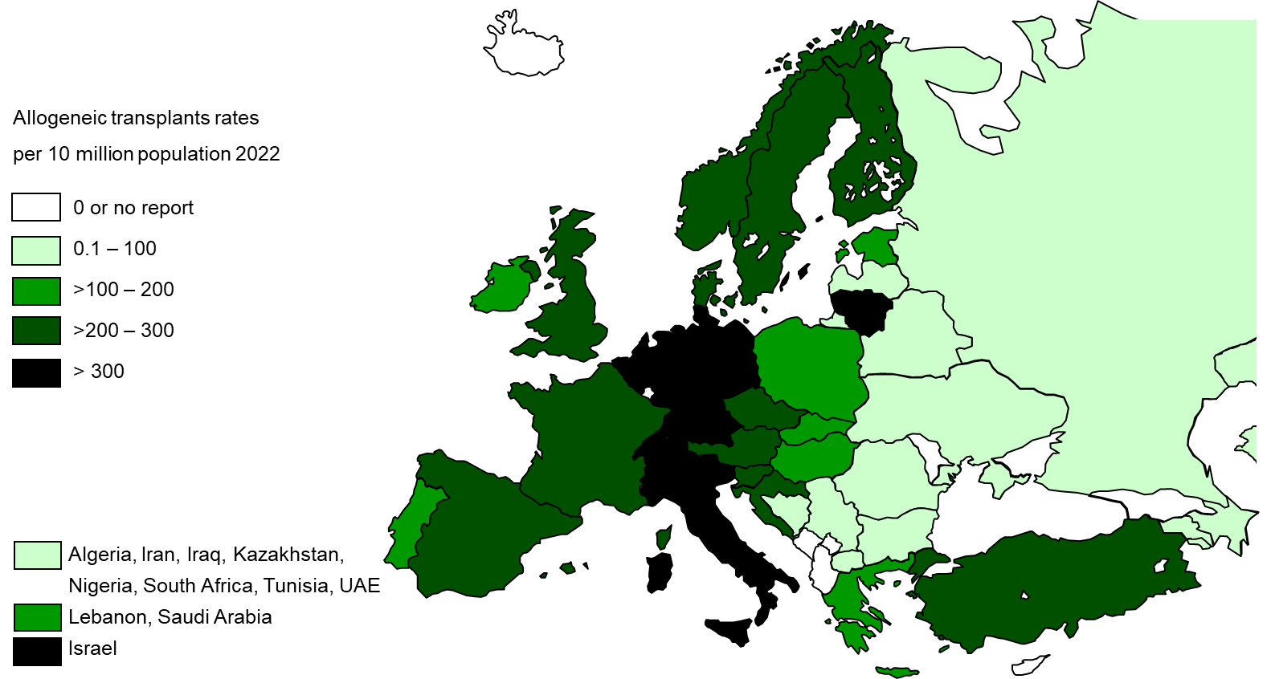
Allogeneic HCT per 10 million population in 2022
Passweg, Baldomero et al. Bone Marrow Transplant. (2024) 59:803–812

Slide 15
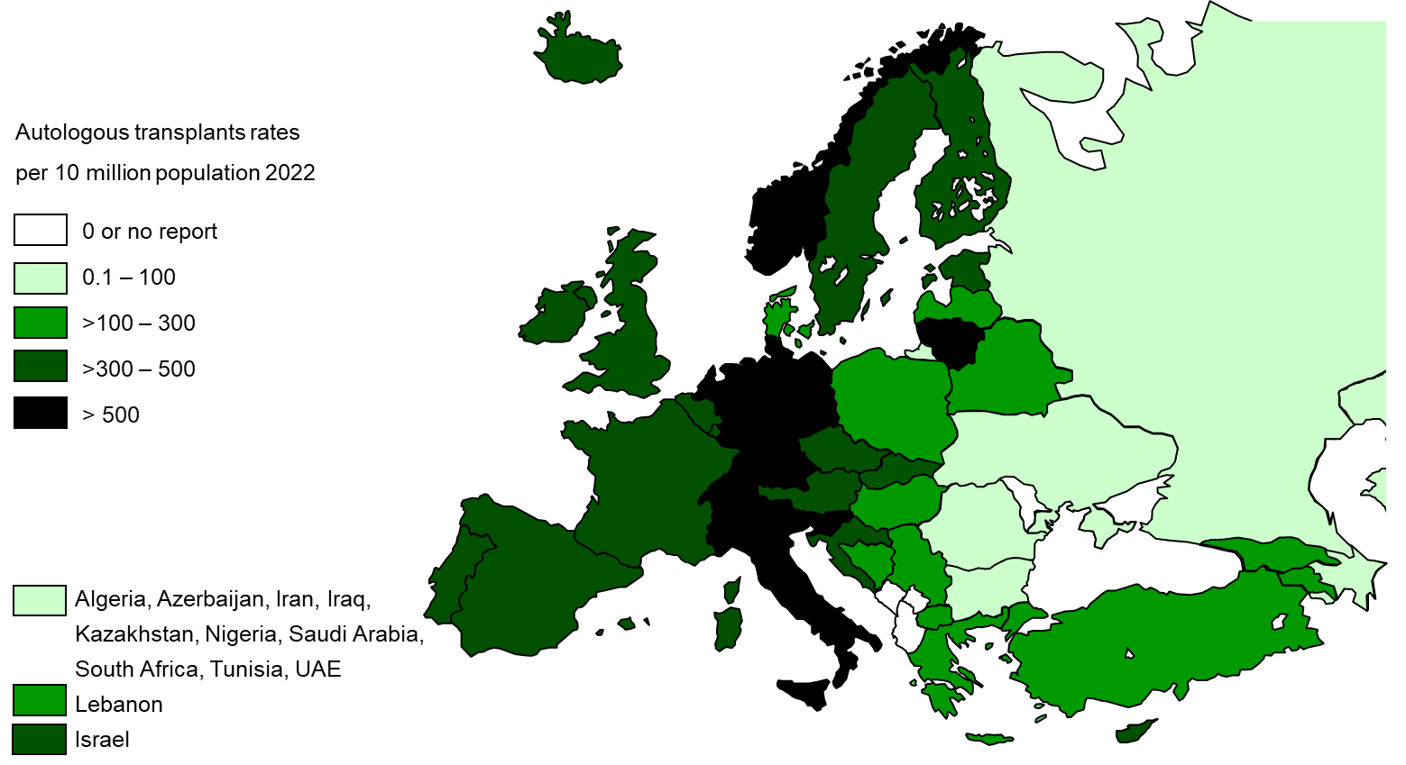
Autologous HCT per 10 million population in 2022
Passweg, Baldomero et al. Bone Marrow Transplant. (2024) 59:803–812

Slide 16
EBMT Activity Survey
on
Cellular therapies
For internal use only. For any other use, please contact Helen Baldomero: helen.baldomero@usb.ch

Slide 17
Cellular therapies in Europe 2022
Number of patients | CAR-T |  | MSC |  | NK cells |  | Selected/expanded T cells or CIK |  | Regulatory T cells (TREGS) |  | Genetically modified T cells |  | Dendritic cells |  | Expanded CD34+ cells |  | Genetically modified CD34+ cells |  | Other |  | Total
 | Allo | Auto | Allo | Auto | Allo | Auto | Allo | Auto | Allo | Auto | Allo | Auto | Allo | Auto | Allo | Auto | Allo | Auto | Allo | Auto | allo | auto
GvHD |  |  | 273 | 1 |  |  | 1 |  | 30 |  |  |  |  |  |  |  |  |  | 13 |  | 317 | 1
Graft enhancement |  |  | 30 |  |  |  | 16 |  |  |  |  |  |  |  | 12 |  |  | 2 | 111 | 50 | 169 | 52
Autoimmune dis. |  | 9 | 11 | 3 |  |  |  |  |  |  |  |  |  |  | 5 |  |  |  | 4 |  | 20 | 12
Genetic disease |  |  |  |  |  |  |  |  |  |  |  |  |  |  |  | 4 | 3 | 19 | 3 |  | 6 | 23
Infection |  |  | 1 | 8 |  |  | 116 | 46 | 4 |  | 7 | 2 |  |  |  |  |  |  | 6 | 1 | 134 | 57
Malignancy - ALL | 44 | 336 |  |  | 19 |  | 18 | 9 |  |  |  | 4 |  | 4 | 1 |  |  |  | 14 |  | 96 | 353
Malignancy - HL/NHL | 1 | 2258 |  |  | 4 | 2 | 23 |  |  |  | 1 |  | 1 |  |  |  |  |  | 1 | 8 | 31 | 2268
Malignancy -myeloma | 3 | 467 |  |  | 7 |  |  |  |  |  |  | 6 |  |  |  |  |  |  | 3 | 12 |  | 485
Malignancy - other indication | 4 | 83 | 15 | 13 | 15 | 3 | 41 | 17 |  |  |  | 19 |  | 20 |  |  |  | 4 | 35 | 23 | 110 | 182
Total | 52 | 3153 | 330 | 25 | 45 | 5 | 215 | 72 | 34 | 0 | 8 | 31 | 1 | 24 | 18 | 4 | 3 | 25 | 190 | 94 | 896 | 3433
DLI for graft enhancement/failure | 804
DLI for residual disease | 393
DLI for relapse | 1294
DLI per protocol | 363
Total | 2854
Passweg, Baldomero et al. Bone Marrow Transplant. (2024) 59:803–812

Slide 18
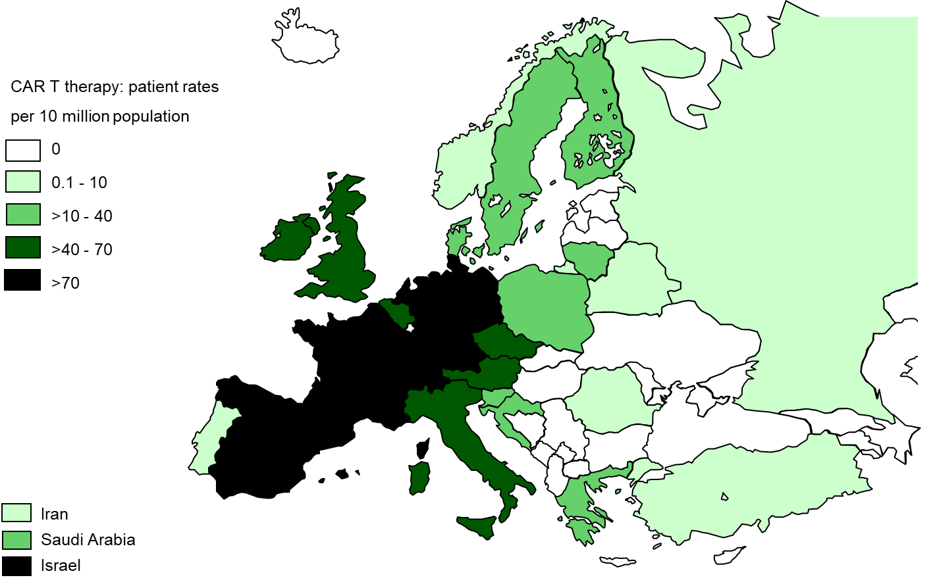
CAR-T per 10 million population in 2022
Passweg, Baldomero et al. Bone Marrow Transplant. (2024) 59:803–812

