Slide 1
EBMT Activity Survey
on HCT 2021
694 Teams
43,109 Patients
47,412 Transplants
52 Countries
If you wish to reuse these slides for internal/external presentation,
please contact Helen Baldomero: helen.baldomero@usb.ch

Slide 2

EBMT Activity Survey in 2021:
Patient and transplant numbers
Allogeneic
HSCT
Autologous
HSCT
Indication
Total
1st allo/1st auto HSCT
Additional HSCT
TOTAL all transplants
Teams: 694 Countries reporting: 52
18,589
1,217
19,806
24,520
3,086
27,606
43,109
4,303
47,412

Slide 3
EBMT Activity Survey in 2021:
Donor type and stem cell source: all transplants
Donor type
BM
PBSC
Cord
Total
HLA-id sibling
Haplo-identical
Other family
Syngeneic
Unrelated
Allogeneic
Autologous
1222
714
56
n.a.
1052
3044
61
4256
3071
178
n.a
8910
16,415
27,545
32
n.a.
2
n.a.
291
325
0
5,510
3,785
236
22
10,253
19,806
27,606

Slide 4
EBMT Activity Survey in 2021:
Main indications
Allogeneic
1st HSCT
Autologous
1st HSCT
Indication
Total
Myeloid (AML, CML, MDS/MPN)
Lymphoid (ALL, CLL, HL, NHL)
Plasma cell disorder
Solid tumor
Non-malignant disorders (all)
bone marrow failure
auto immune disease
Other
Total Patients
10,745
4858
269
52
2501
986
20
164
18,589
227
8754
13,375
1635
503
2
468
26
24,520
10,972
13,612
13,644
1687
3004
988
488
190
43,109

Slide 5
EBMT Activity Survey in 2021
Lymphoid neoplasia
Allogeneic
1st Tx.
Autologous
1st Tx.
Indication
Total
PCD - Myeloma
PCD - Other
HD
NHL
233
36
410
1115
12,937
438
2,295
6,348
13,170
474
2,705
7,463

Slide 6
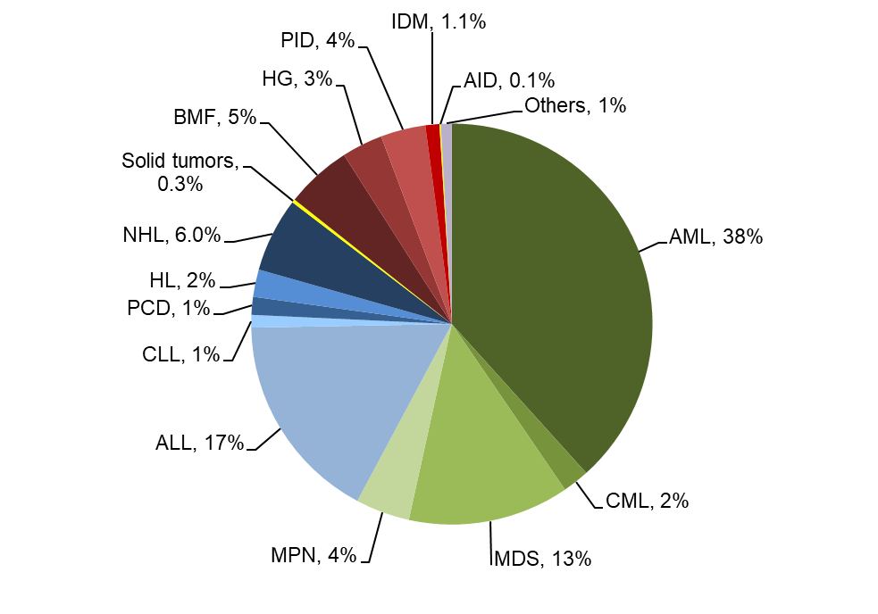
Allogeneic HCT in Europe 2021: 1st HCT
Passweg, Baldomero et al. Bone Marrow Transplant. 2023 Mar 6:1-12

Slide 7
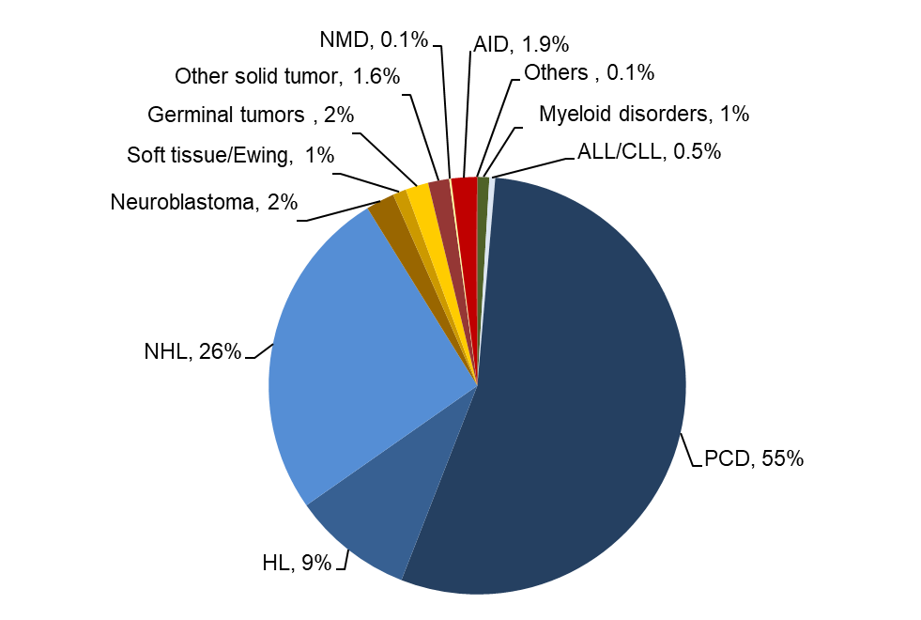
Autologous HCT in Europe 2021: 1st HCT
Passweg, Baldomero et al. Bone Marrow Transplant. 2023 Mar 6:1-12

Slide 8
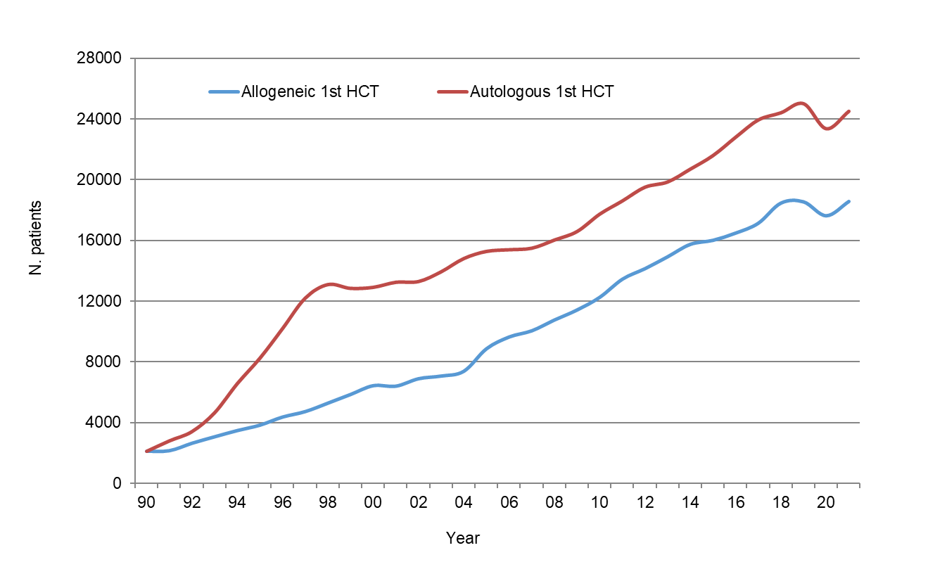
HCT activity in Europe 1990-2021:
allogeneic vs autologous HCT
Passweg, Baldomero et al. Bone Marrow Transplant. 2023 Mar 6:1-12

Slide 9
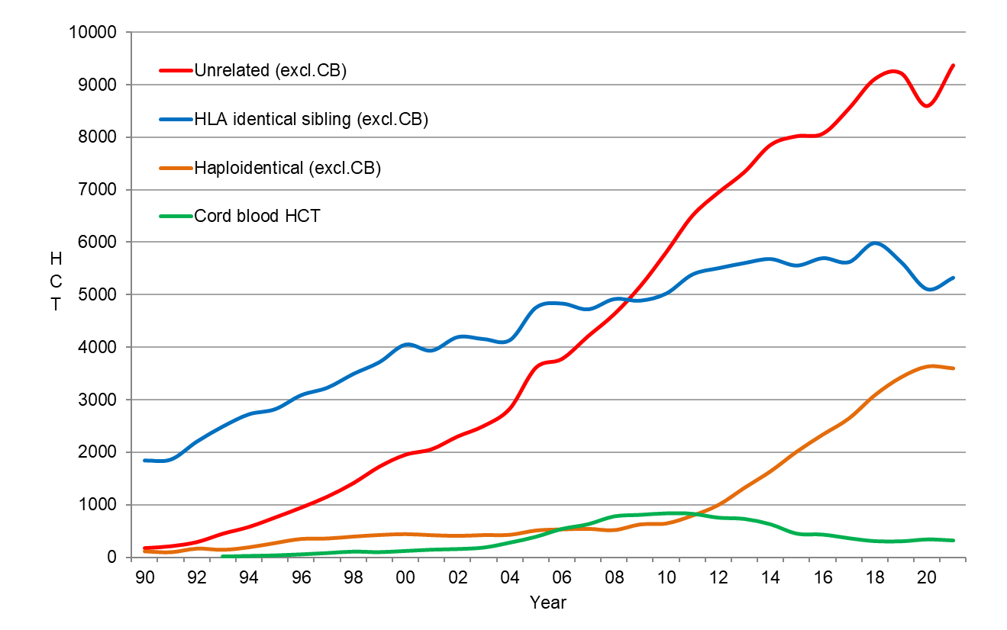
HCT activity in Europe 1990-2021:
donor origin: 1st HCT
Passweg, Baldomero et al. Bone Marrow Transplant. 2023 Mar 6:1-12

Slide 10
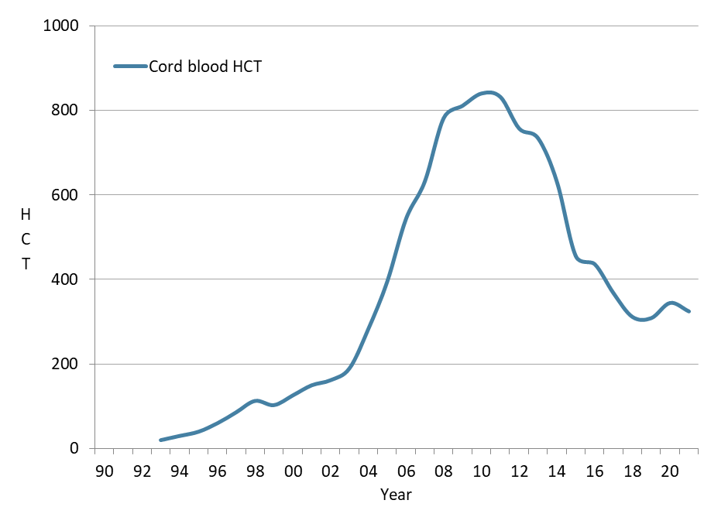
HCT activity in Europe 1990-2021:
cord blood HCT: all transplants

Slide 11
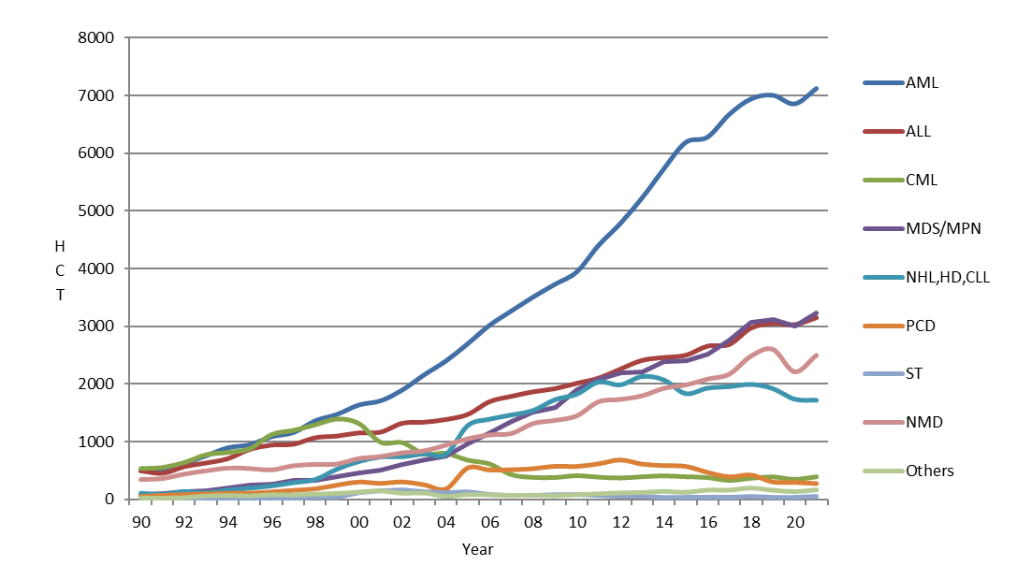
HCT activity in Europe 1990-2021:
main indication: allogeneic HCT

Slide 12
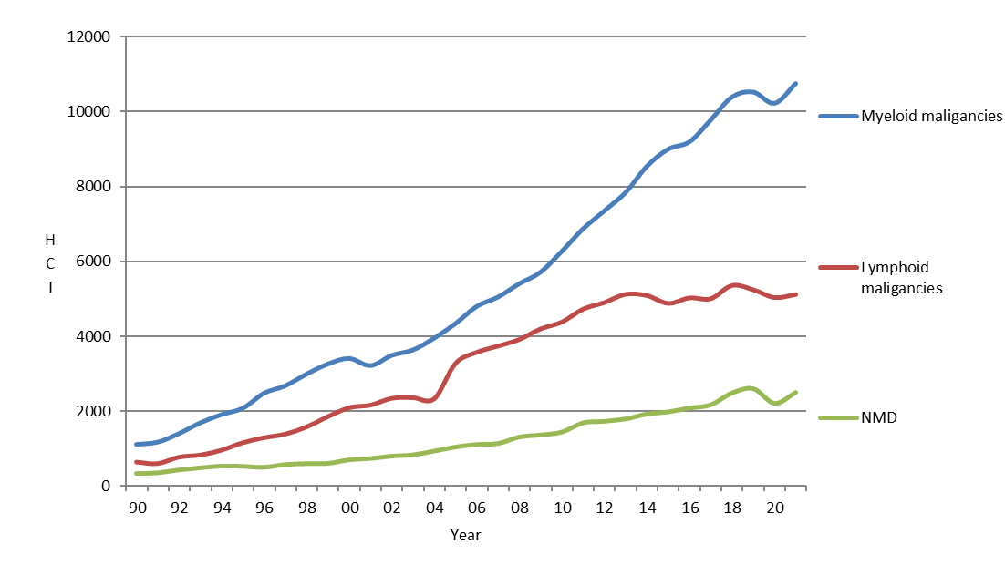
HCT activity in Europe 1990-2021:
myeloid disorders: allogeneic HCT

Slide 13
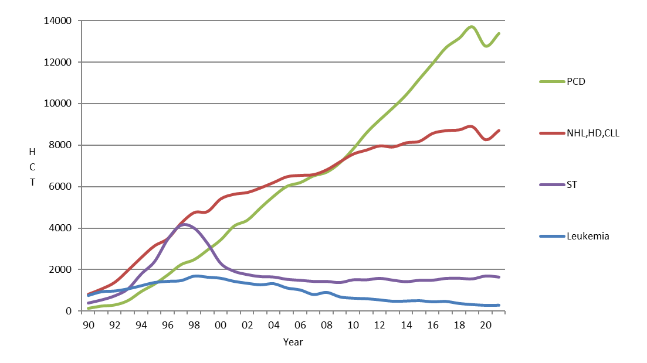
HCT activity in Europe 1990-2021:
main indication: autologous HCT

Slide 14
EBMT Activity Survey
on
Cellular therapies
For internal use only.
For any other use, please contact Helen Baldomero: helen.baldomero@usb.ch

Slide 15
Cellular therapies in Europe 2021
Number of patients | DLI | CART |  | MSC |  | NK cells |  | selected/expanded T cells or CIK |  | Regulatory T cells (TREGS) |  | Genetically modified T cells |  | Dendritic cells |  | Expanded CD34+ cells |  | Genetically modified CD34+ cells |  | Other
 |  | Allo | Auto | Allo | Auto | Allo | Auto | Allo | Auto | Allo | Auto | Allo | Auto | Allo | Auto | Allo | Auto | Allo | Auto | Allo | Auto
GvHD |  |  |  | 280 | 1 |  |  |  |  | 7 | 1 | 1 |  | 1 |  | 1 |  |  |  | 1 | 6
Graft enhancement |  |  |  | 25 |  |  |  | 8 | 17 | 2 |  |  |  |  |  | 7 |  | 2 |  | 152 | 37
Autoimmune dis. |  |  | 4 | 17 | 8 |  |  |  |  |  |  |  |  |  |  |  | 1
Genetic disease |  |  |  |  |  |  |  |  |  |  |  |  |  |  |  |  |  |  | 29
Infection |  |  |  | 13 |  | 9 |  | 135 | 15 | 5 |  | 7 | 3 |  |  |  |  |  |  | 5 | 3
Malignancy - ALL |  | 42 | 337 | 5 |  | 9 | 1 | 10 |  | 1 |  |  |  |  | 5 |  |  | 2 |  | 4
Malignancy - HL/NHL |  | 4 | 1847 |  |  |  | 1 | 5 |  |  |  |  | 1 | 1 |  | 1 |  |  |  |  | 5
Malignancy - Other |  | 12 | 278 |  |  | 13 | 3 | 21 | 13 |  |  | 2 | 15 |  | 17 |  |  | 3 |  | 16 | 17
DLI for graft enhancement/failure | 848
DLI for residual disease | 540
DLI for relapse | 1377
DLI per protocol | 480
Total | 3245 | 58 | 2466 | 340 | 9 | 31 | 5 | 179 | 45 | 15 | 1 | 10 | 19 | 2 | 22 | 9 | 1 | 7 | 29 | 178 | 68
Passweg, Baldomero et al. Bone Marrow Transplant. 2023 Mar 6:1-12

Slide 16
