Slide 1
EBMT Activity Survey
on HCT 2020 690 Teams 41,016 Patients 45,364 Transplants 50 Countries
For internal use only. For any other use, please contact Helen Baldomero: helen.baldomero@usb.ch

Slide 2
EBMT Activity Survey in 2020: Patient and transplant numbers
Allogeneic
HSCT
Autologous
HSCT
Indication
Total
1st allo/1st auto HSCT
Additional HSCT
TOTAL all transplants
Teams: 690 Countries reporting: 50
17,647
1,149
18,796
23,369
3,199
26,568
41,016
4,348
45,364

Slide 3
EBMT Activity Survey in 2020: Donor type and stem cell source: all transplants
Donor type
BM
PBSC
Cord
Total
HLA-id sibling
Haplo-identical
Other family
Syngeneic
Unrelated
Allogeneic
Autologous
1,169
667
87
n.a.
888
2,811
57
4,070
3,123
195
n.a
8,228
15,616
26,510
36
n.a.
11
n.a.
298
345
1
5,275
3,790
293
24
9,414
18,796
26,568

Slide 4
EBMT Activity Survey in 2020: Main indications
Allogeneic
1st HSCT
Autologous
1st HSCT
Indication
Total
Myeloid (AML, CML, MDS/MPN)
Lymphoid (ALL, CLL, HL, NHL)
Plasma cell disorder
Solid tumor
Non-malignant disorders (all)
bone marrow failure
auto immune disease
Other
Total Patients
10,217
4,757
289
36
2,213
902
18
135
17,647
224
8308
12,766
1,686
319
1
298
66
23,369
10,441
13,065
13,055
1,722
2,532
903
316
201
41,016

Slide 5
EBMT Activity Survey in 2020: Lymphoid neoplasia
Allogeneic
1st Tx.
Autologous
1st Tx.
Indication
Total
PCD - Myeloma
PCD - Other
HD
NHL
259
30
375
1,189
12,365
401
2,134
6,087
12,624
431
2,509
7,276

Slide 6
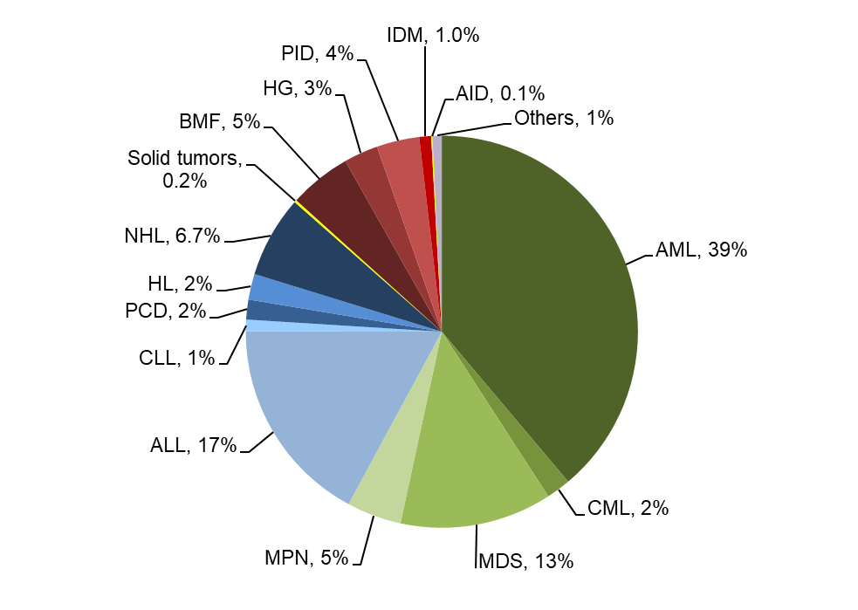
Allogeneic HCT in Europe 2020: 1st HCT
Passweg, Baldomero et al. Bone Marrow Transplant. 2022 May;57(5):742-752

Slide 7
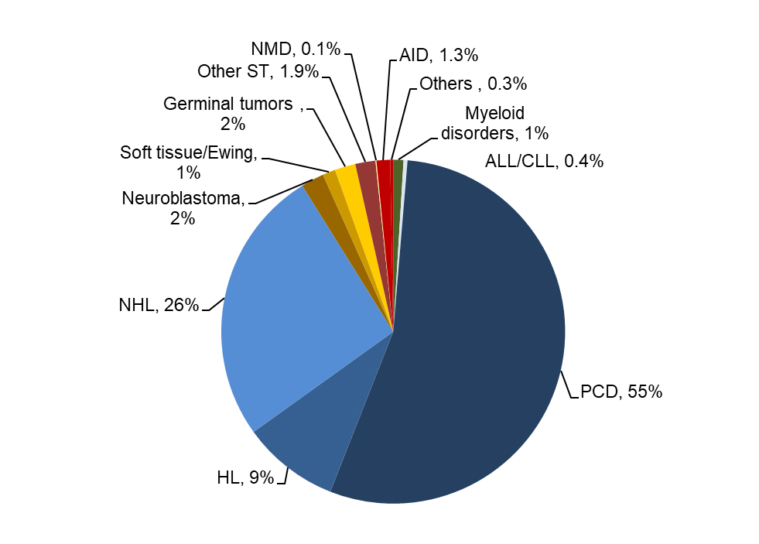
Autologous HCT in Europe 2020: 1st HCT
Passweg, Baldomero et al. Bone Marrow Transplant. 2022 May;57(5):742-752

Slide 8
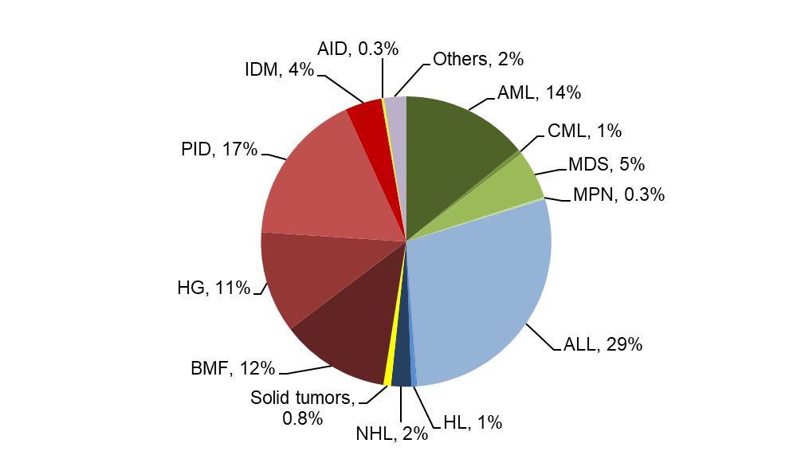
Allogeneic HCT in Europe 2020: 1st HCT
in 124 dedicated pediatric centres

Slide 9
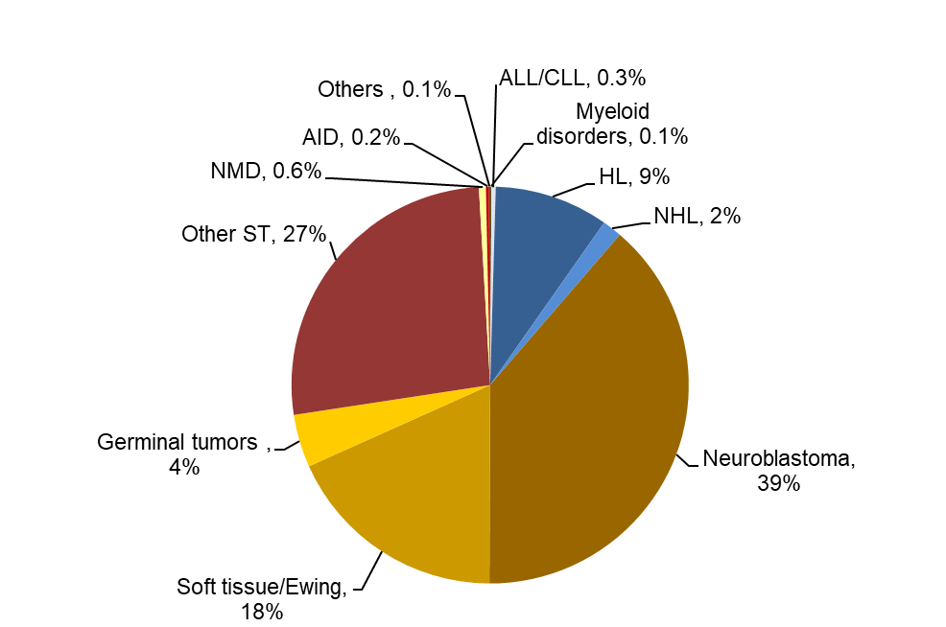
Autologous HCT in Europe 2020: 1st HCT
in 124 dedicated pediatric centres update

Slide 10
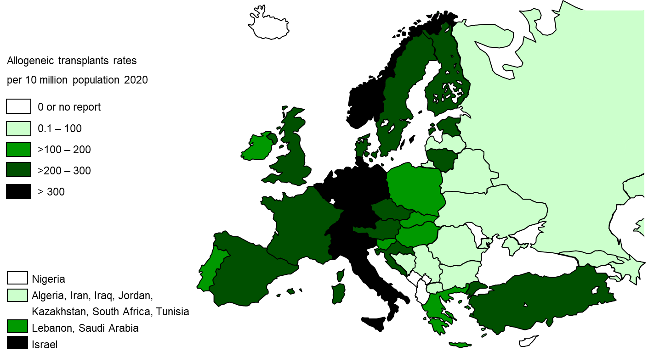
Allogeneic TR in Europe 2020

Slide 11
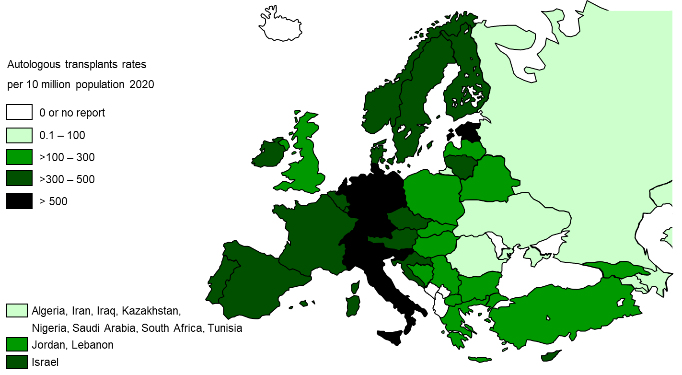
Autologous TR in Europe 2020

Slide 12
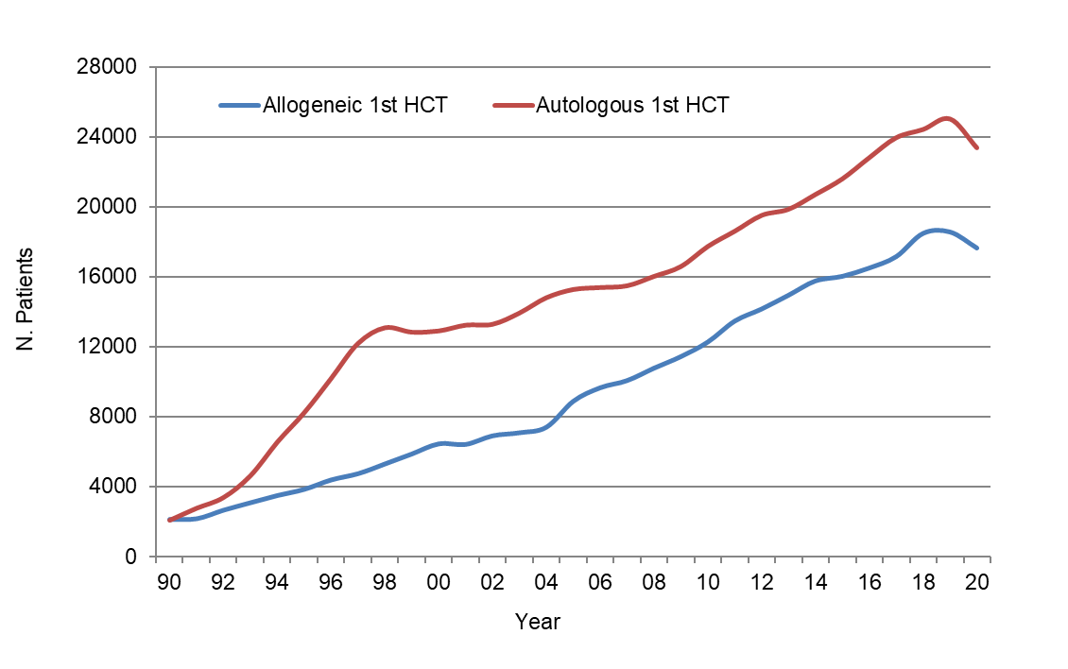
HCT activity in Europe 1990-2020: allogeneic vs autologous HCT

Slide 13
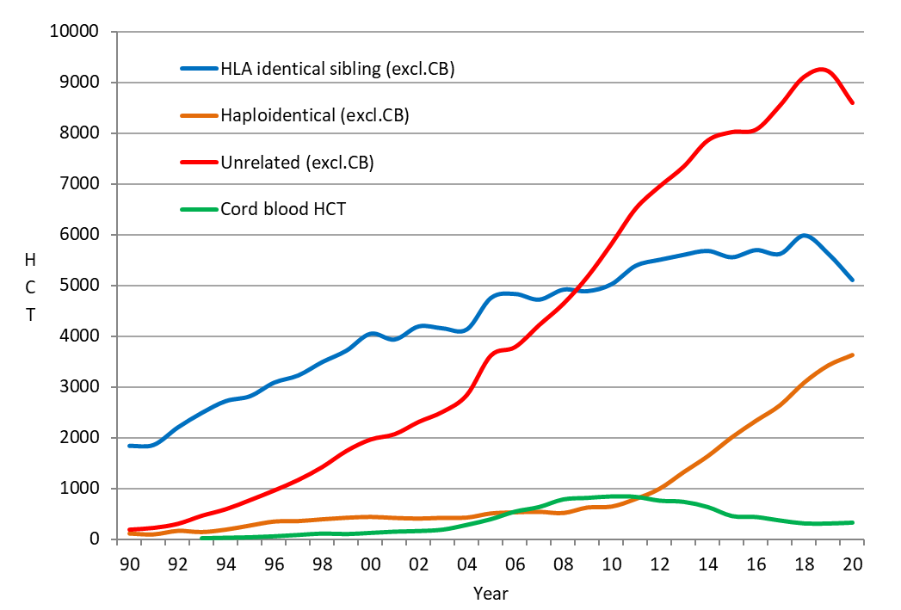
HCT activity in Europe 1990-2020: donor origin: 1st HCT
Passweg, Baldomero et al. Bone Marrow Transplant. 2022 May;57(5):742-752

Slide 14
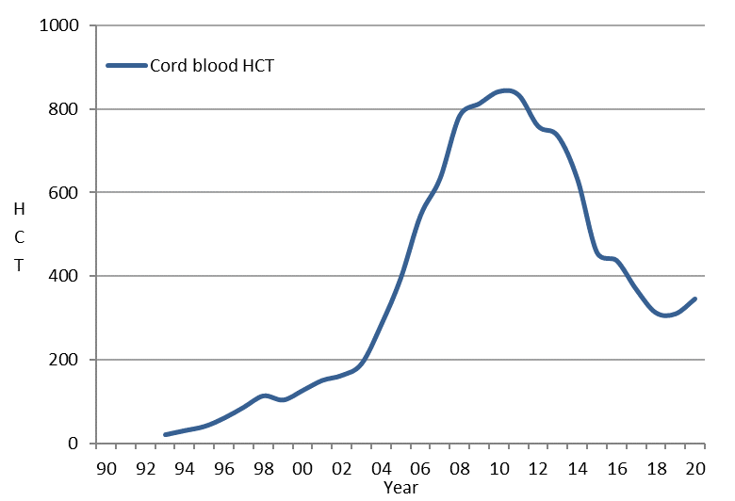
HCT activity in Europe 1990-2020: cord blood HCT: all transplants

Slide 15
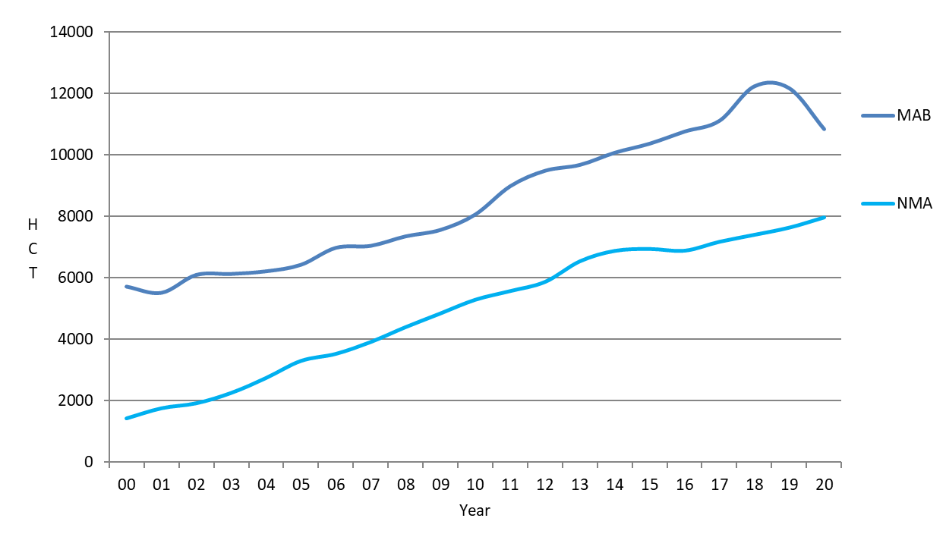
HCT activity in Europe 2000-2020: conditioning regimen: allogeneic HCT
Passweg, Baldomero et al. Bone Marrow Transplant. 2022 May;57(5):742-752

Slide 16
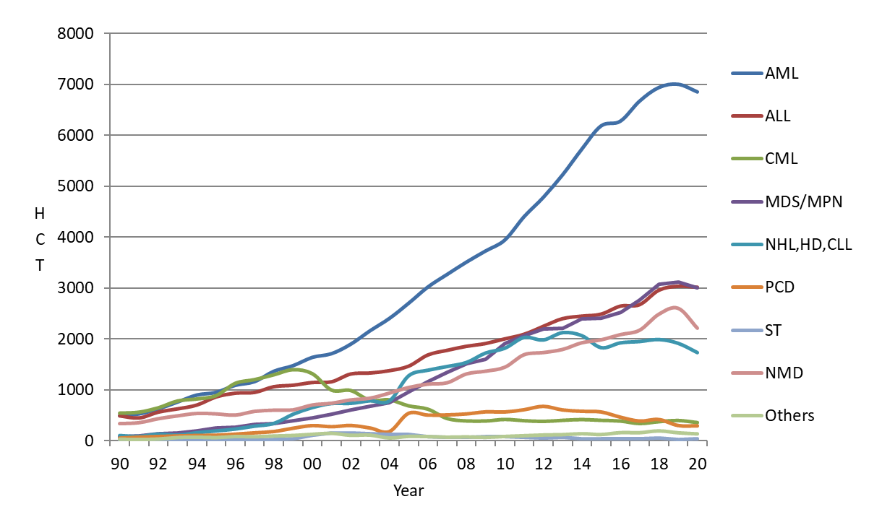
HCT activity in Europe 1990-2020: main indication: allogeneic HCT

Slide 17
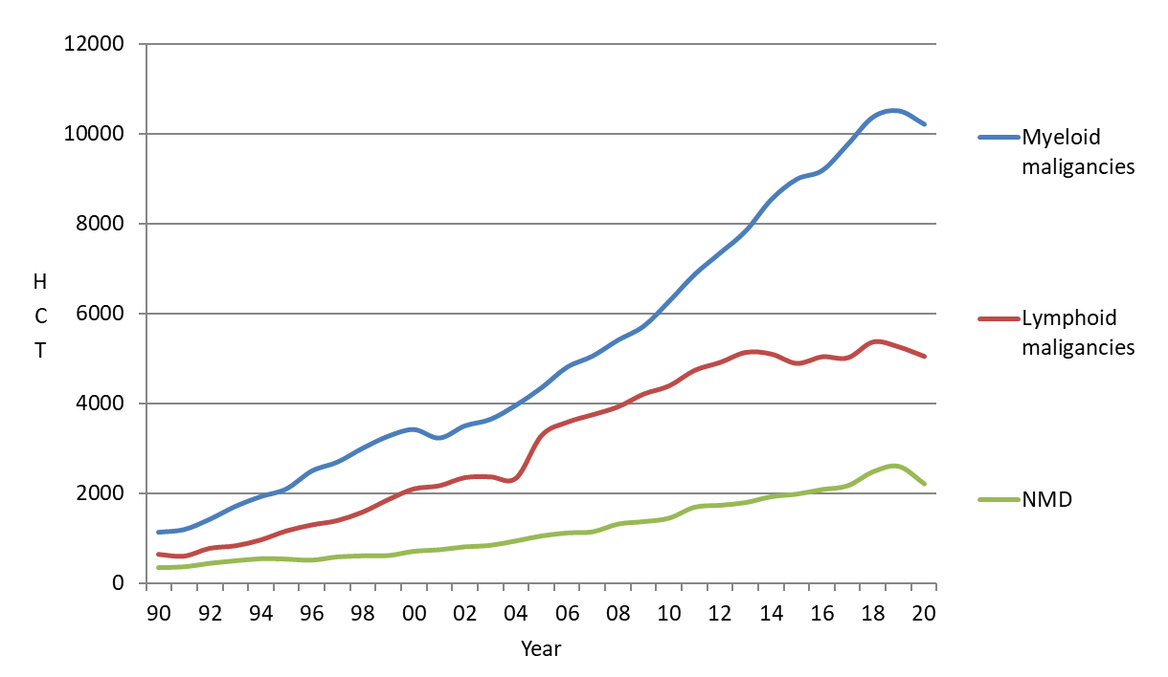
HCT activity in Europe 1990-2020: myeloid disorders: allogeneic HCT

Slide 18
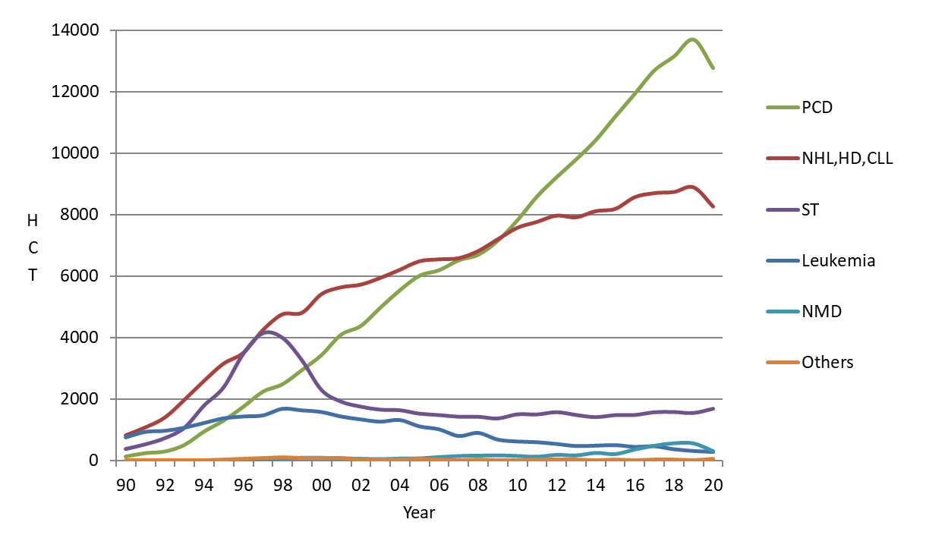
HCT activity in Europe 1990-2020: main indication: autologous HCT
Passweg, Baldomero et al. Bone Marrow Transplant. 2022 May;57(5):742-752

Slide 19
EBMT Activity Survey
on
Cellular therapies
For internal use only. For any other use, please contact Helen Baldomero: helen.baldomero@usb.ch

Slide 20
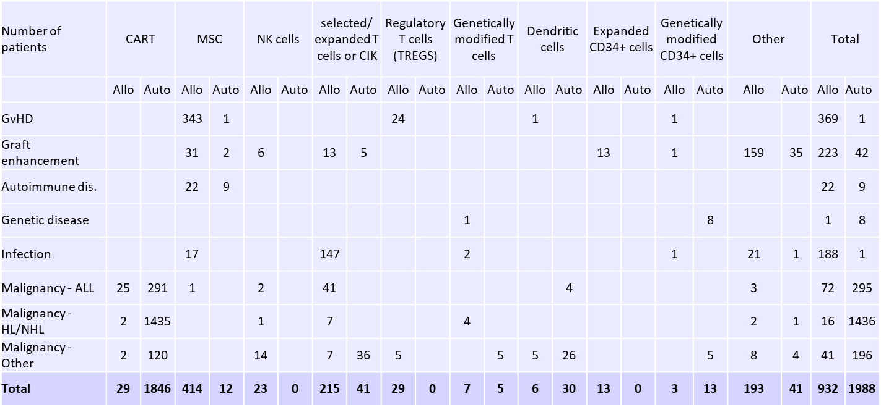
Cellular therapies in Europe 2020
Passweg, Baldomero et al. Bone Marrow Transplant. 2022 May;57(5):742-752

Slide 21
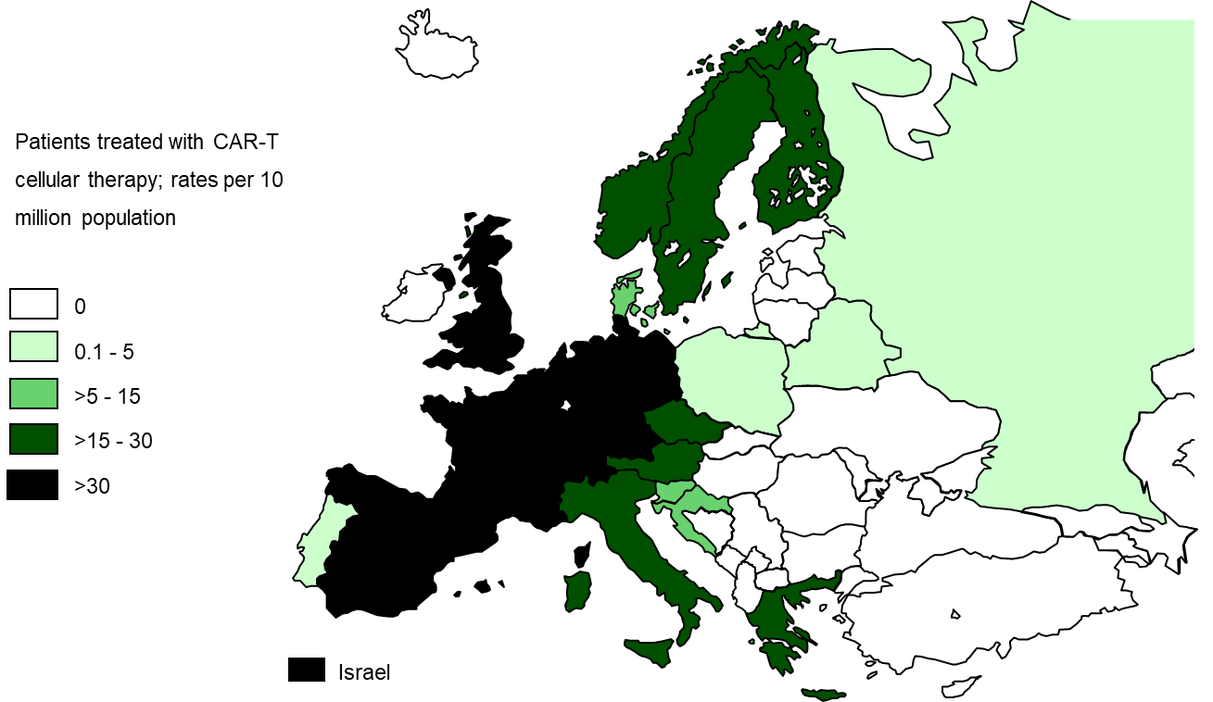
CAR-T rates per 10 million population in Europe 2020

