Slide 1
What have we learnt?
Silvia Montoto, on behalf of the EDI working group

Slide 2
Disclosures
None

Slide 3
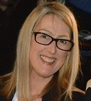
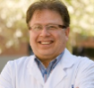
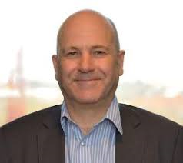
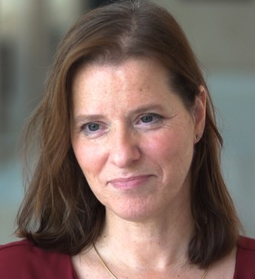
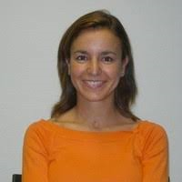
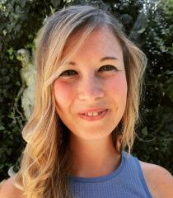


Equality, Diversity and Inclusion working group

Slide 4
First steps: gather information
Composition of EBMT members and staff: quantitative survey
Views of EBMT members and staff: qualitative survey

Slide 5
Quantitative survey
29/11/20-29/12/20
Sent to 12,862 recipients
Role at EBMT
Sex
Gender identity
Country of origin
Ethnicity
Age
Sexual Orientation
Main carer
Disability
Religion/belief
Replies: 368 (245 members, 34 staff, 83 other/NR)-3%

Slide 6
Quantitative survey-role at EBMT
362 replies
68%
Included: non-member physicians, non-member nurses, conference attendees
23%

Slide 7
Quantitative survey-Sex, Gender identity
Sex: 65% ♀, 35% ♂, 1% binary/prefer not to say
In 99% of the responders, the gender was the same as assigned at birth

Slide 8
Quantitative survey-country of origin

Slide 9
Quantitative survey-ethnic group

Slide 10
Quantitative survey-age group

Slide 11
Quantitative survey-sexual orientation

Slide 12
Quantitative survey-looking after others
40%
41%
34%
32%
26%
23%

Slide 13
Quantitative survey-disability
95%
100%

Slide 14
Quantitative survey-religion/belief

Slide 15
Qualitative survey
15/11/20-29/12/20
Sent to 12,866 recipients
Are you happy that the EBMT is paying more attention to equality, diversity and inclusion in order to widen the range of people in its volunteer and staff roles? If so, why?
What's your view of the current diversity of those in voluntary and staff roles at the EBMT?
What might stop or discourage you or other people from applying for voluntary/staff roles with the EBMT at present?
What might have stopped you or other people from being successful when applying for voluntary/staff roles with the EBMT in the past?
What might facilitate or encourage you, or what new steps by EBMT might help you or other people, to stand for or apply for voluntary/staff posts with the EBMT in the future?
What would help people from under-represented groups to be more successful when applying for voluntary/staff roles in the future?
Replies: 143 members, 39 staff and 9 ‘others’- 1.5%

Slide 16
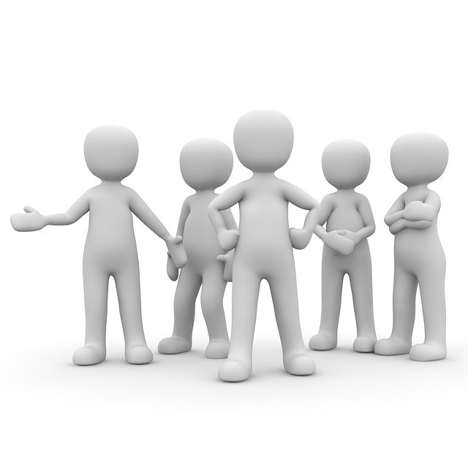
Qualitative survey- Are you happy that the EBMT is paying more attention to equality, diversity and inclusion in order to widen the range of people in its volunteer and staff roles? If so, why?
EBMT as a modern organisation reflecting current society
Of course. EBMT governance platforms should represent the wider society we are serving
This is to be expected in a modern, developing organisation
Knowing that you respect diversity is important to me
We should be promoters of change not mere observers
This is urgently needed

Slide 17
Qualitative survey- Are you happy that the EBMT is paying more attention to equality, diversity and inclusion in order to widen the range of people in its volunteer and staff roles? If so, why?
The benefits of diversity
The best talent can only be recruited from the largest pool
Diversity will create more loyalty to EBMT, adding confidence and trust in its approaches
Diversity means richness
Diversity always leads to more creativity, improved productivity and higher impact

Slide 18
Qualitative survey- Are you happy that the EBMT is paying more attention to equality, diversity and inclusion in order to widen the range of people in its volunteer and staff roles? If so, why?
Impact of diversity on the care of our patients
This work will help include underserved populations in reports or clinical trials and this will help
mitigate disparity in clinical outcomes
In this way we can better serve our patients

Slide 19
Qualitative survey- Are you happy that the EBMT is paying more attention to equality, diversity and inclusion in order to widen the range of people in its volunteer and staff roles? If so, why?
Views on the current composition of EBMT
Currently I don't fit in. EBMT feels like a “gentlemen's club”
It's a testosterone-fuelled organisation

Slide 20
Qualitative survey- Are you happy that the EBMT is paying more attention to equality, diversity and inclusion in order to widen the range of people in its volunteer and staff roles? If so, why?
Not an important issue
In an ideal situation time could be wasted on this. It seems to me
a cosmetic exercise of no relevance
I really don't care
EBMT should not follow fashion

Slide 21
Qualitative survey-What's your view of the current diversity of those in voluntary and staff roles at the EBMT?
Senior roles are mostly male. Women are underrepresented
Predominance of white men
Mostly white men. It feels like a private club. Very difficult to access
EBMT needs to be inclusive to a new generation of staff and physicians
We don't look like the population that we want to serve
It's mainly white men in the powerful positions
The Board does not include the excellent female professors in the field. In general
lower income countries are not represented
Everyone I work with with one exception is Caucasian. This lack of diversity is reflected in the different Working Parties

Slide 22
Qualitative survey-What's your view of the current diversity of those in voluntary and staff roles at the EBMT?
Limited geographical diversity
Smaller or Eastern regions are not represented
The current Board has a majority of South and West European males
In the nurses' groups we have a majority of women but not all countries that are EBMT members are represented
We should include Members from outside Europe (Turkey, India, Brazil for example)

Slide 23
Qualitative survey-What's your view of the current diversity of those in voluntary and staff roles at the EBMT?
The board reflects white male society
There is a white male predominance which is understandable for clinicians given the group from which they are recruited
The Board reflects medicine beyond the EBMT. Men appear as directors and leaders

Slide 24
Qualitative survey-
What might stop or discourage you or other people from applying for voluntary/staff roles with the EBMT at present?
What might have stopped you or other people from being successful when applying for voluntary/staff roles with the EBMT in the past?
What might facilitate or encourage you, or what new steps by EBMT might help you or other people, to stand for or apply for voluntary/staff posts with the EBMT in the future?
What would help people from under-represented groups to be more successful when applying for voluntary/staff roles in the future?

Slide 25
Qualitative survey-
Difficult access: closed club
I don't think I've ever seen an EBMT staff role advertised
When I applied, there was no feedback. This encouraged me not to apply in future
It appears to be a boys' club that encourages similar types of people to apply
Senior figures should encourage others to participate
Elitist aura and language
It's not good enough simply to advertise the roles. EBMT should actively seek and encourage people from under-represented groups
Positions are divided among senior members without inclusion of new members

Slide 26
Qualitative survey-
Lack of time and support
Time commitments [discourage people] particularly where employers are not supportive
I’m too involved in taking care of patients to actively contribute
Heavy workload in main place of work

Slide 27
What have we learnt?
Some information on the composition of the EBMT
Some information on the views of members and staff
More information is necessary
Commitment of the board

Slide 28
Thanks!

