Slide 1
DESIGN GUIDELINES:
Titles font: ARIAL BOLD
Subtitles font: ARIAL REGULAR
Body text font: ARIAL REGULAR
Dark blue: #3a4f92 – RGB: 58/79/146
Turquoise blue: #2899B6 – RGB: 40/153/182
Logo: do not add extra logos or modify the existing ones

Slide 2
10 tips for an awesome Power Point Presentation
Respect the design guidelines, use only the EBMT template colors and fonts
Don’t add the EBMT logo on every slide, they take up a lot of space that could be used to get your message across. They already know who you are ;)
Keep it clean and simple, limit the number of slides
Use key phrases and include only essential information
Use high-quality images that reinforce and complement your message
Choose the appropriate charts to explain the topic of the slide
Respect the spaces and margins, let your presentation breathe
Spend time in the slide sorting, know how to navigate your presentation
Bullet points should appear one at a time so the audience listens to the presenter
Time your presentation, speak comfortably and clear
… relax and enjoy!

Slide 3
This is your presentation title
I am Martin Smith @username

Slide 4
This is your presentation title
I am Martin Smith @username

Slide 5
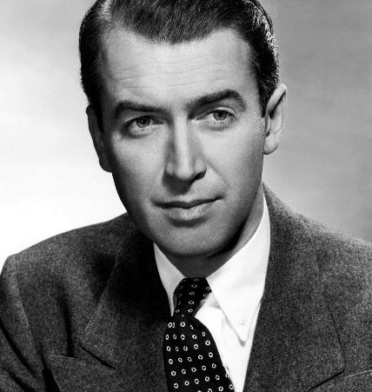
Hello!
I am Martin Smith
Hospital:
City/Country:
You can find me at @username

Slide 6
Transition headline
Let’s start with the first set of slides

Slide 7
Quotations are commonly printed as a means of inspiration and to invoke philosophical thoughts from the reader.

Slide 8
This is a slide title
Here you have a list of items
And some text
But remember not to overload your slides with content
Your audience will listen to you or read the content, but won’t do both.

Slide 9
BIG
CONCEPT
Bring the attention of your audience over a key concept using icons or illustrations

Slide 10
You can also split your content
White
Is the color of milk and fresh snow, the color produced by the combination of all the colors of the visible spectrum.
Black
Is the color of coal, ebony, and of outer space. It is the darkest color, the result of the absence of or complete absorption of light.

Slide 11
In two or three columns
Yellow
Is the color of gold, butter and ripe lemons. In the spectrum of visible light, yellow is found between green and orange.
Blue
Is the colour of the clear sky and the deep sea. It is located between violet and green on the optical spectrum.
Red
Is the color of blood, and because of this it has historically been associated with sacrifice, danger and courage.

Slide 12
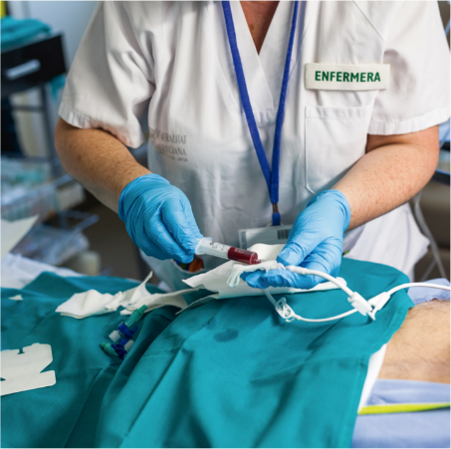
A picture is worth a thousand words
A complex idea can be conveyed with just a single still image, namely making it possible to absorb large amounts of data quickly.

Slide 13
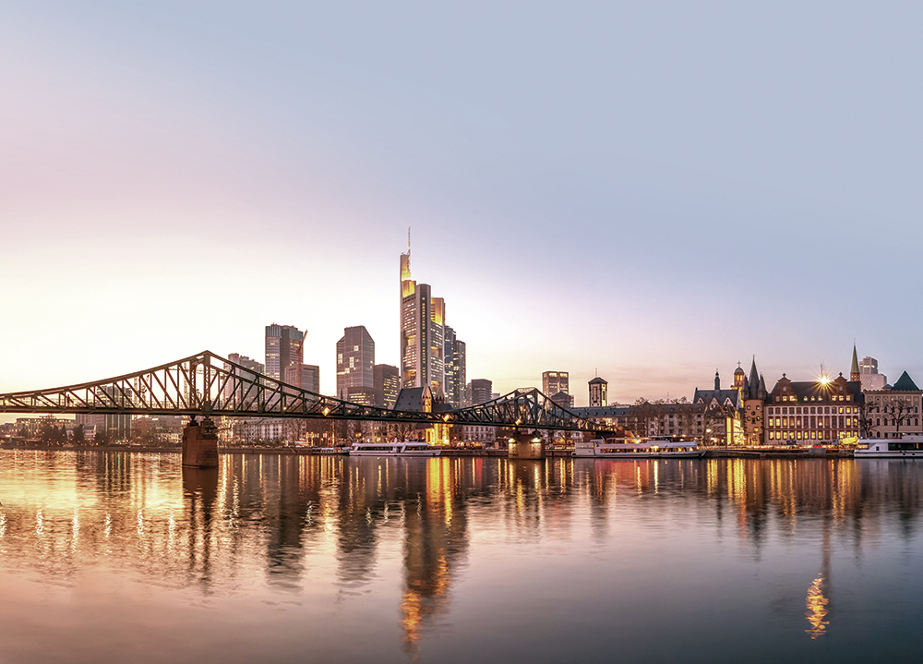
Want big impact?
Use big image
(replace the format background image)

Slide 15
Use charts to explain your ideas

Slide 16
And tables to compare data
Project Title | One | Two | Three | Four
Project One | 100 | 30 | 2 | 4600
Project Two | 40 | 1900 | 400 | 7
Project Three | 500 | 300 | 1000 | 170

Slide 18
Map
our office

Slide 19
89,526,124
That’s a big number,
aren’t you proud?

Slide 20
89,526,124$
That’s a lot of money
185,244 users
And a lot of users
100%
Total success!

Slide 21
Thanks!
Any questions?
@username
user@mail.me
ebmt.org

